Slide 1
State Veterans Commission Meeting
September 5, 2014

Slide 2
Vietnam
Commemorative Partner Program

Slide 4
MISSION
The Commemorative Partner Program (CPP) is designed for Federal agencies, States, local civilian and military communities, international governments, veterans’ organizations, civic groups, industries, educational institutions, libraries, museums, business and other organizations to assist a grateful nation in thanking and honoring our Vietnam Veterans and their families to include those who lost loved ones during the war and those families still awaiting the fullest possible accounting of their loved one.
It is both a multi-level government and community grass-roots outreach initiative designed to achieve the following five objectives outlined in the 2008 National Defense Authorization Act
As of 20 AUG 14
> community > commonwealth
> country
As of 20 AUG 14
> community > commonwealth
> country

Slide 5
FIVE OBJECTIVES
To thank and honor veterans of the Vietnam War, including personnel who were held as prisoners of war or listed as missing in action, for their service and sacrifice on behalf of the United States and to thank and honor the families of these veterans.
To highlight the service of the Armed Forces during the Vietnam War and the contributions of Federal agencies and governmental and non-governmental organizations that served with, or in support of, the Armed Forces.
To pay tribute to the contributions made on the home front by the people of the United States during the Vietnam War.
To highlight the advances in technology, science, and medicine related to military research conducted during the Vietnam War.
To recognize the contributions and sacrifices made by the allies of the United States during the Vietnam War.
As of 20 AUG 14
> community > commonwealth
> country
As of 20 AUG 14
> community > commonwealth
> country

Slide 6
RESPONSIBILITIES
During the period of 2015-2017, Commemorative Partners will plan and conduct at least two appropriate events and activities each year that will “thank and honor” our Vietnam Veterans and their families in a memorable, dignified and special manner. Events and activities should be designated to demonstrate a sensitivity and appreciation for the solemnity of the Vietnam War and the losses suffered by Vietnam service members.
Failure to comply will remove the Partner from the program
AARs are required after each event
Additional Events are encouraged
As of 20 AUG 14
> community > commonwealth
> country
As of 20 AUG 14
> community > commonwealth
> country

Slide 7
SUGGESTED EVENTS / ACTIVITIES
Dedicate military installation open house each year for the period of 2015-2017 to thank and honor Vietnam Veterans and their families
Participate in local parades with color guard or marching unit in Vietnam era uniforms.
Organize volunteer groups, military and civilian, to visit veteran’s or group homes, care facilities and hospitals.
Conduct wreath-laying ceremonies to honor Vietnam Veterans at national, state, and local cemeteries and at Vietnam Veteran Ware Memorials/Monuments
Use posters and facsimile reproduction of photographs, documents, or quotes to create a Vietnam corridor in a facility.
Designate a representative to actively represent your organization on local community or state commemorative committees for events honoring Vietnam Veterans and their families
Enhance organizational Vietnam War commemorative events with the addition of a local Vietnam veteran or national speaker at schools, social, veteran and civic groups.
As of 20 AUG 14
> community > commonwealth
> country
As of 20 AUG 14
> community > commonwealth
> country

Slide 8
SUPPORT MATERIALS
As of 20 AUG 14
> community > commonwealth
> country
As of 20 AUG 14
> community > commonwealth
> country

Slide 9
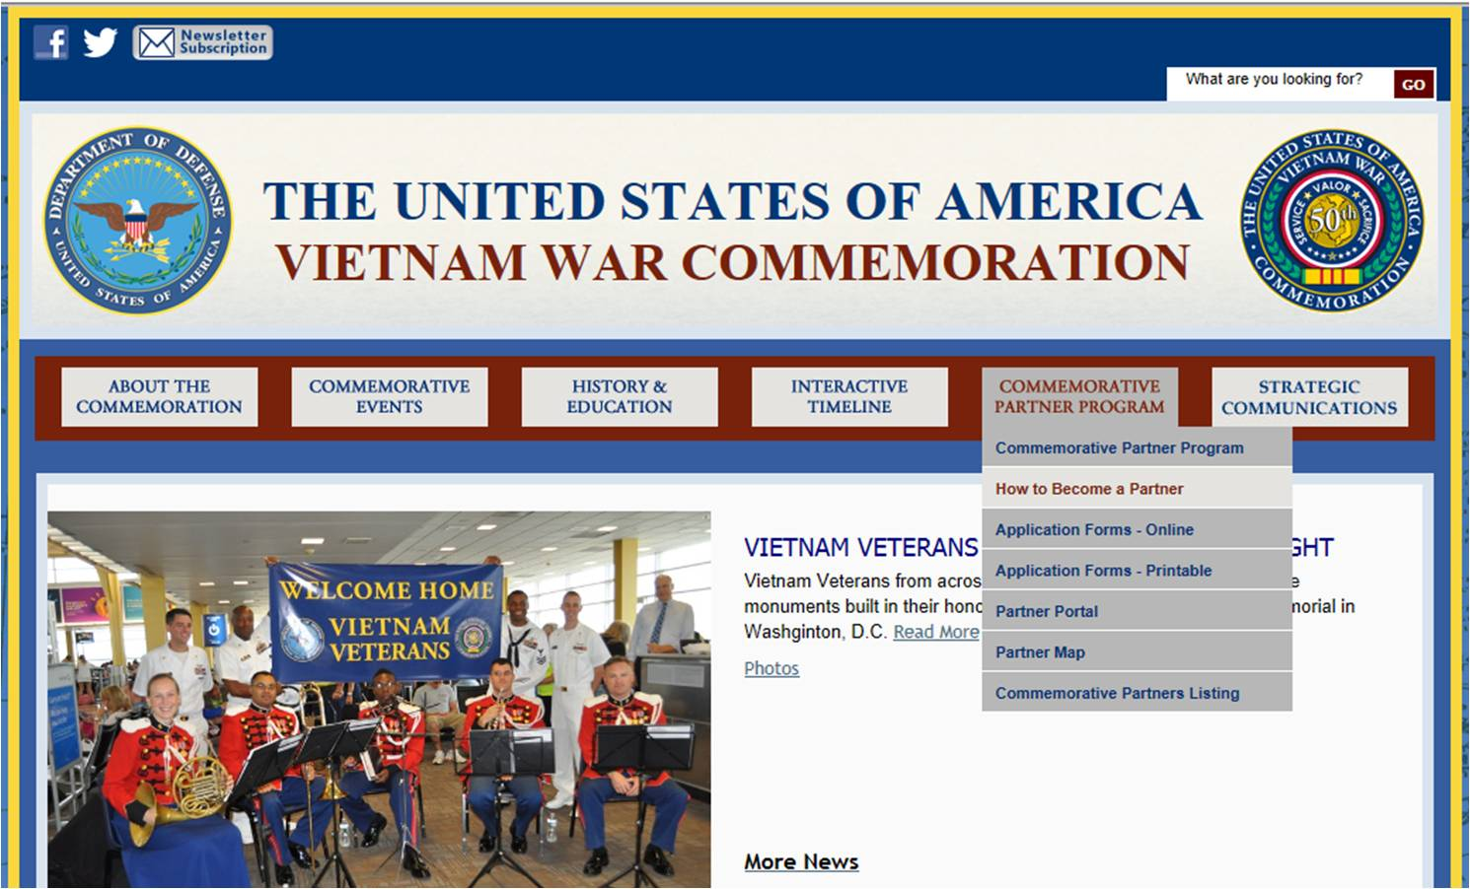
WEBSITE
http://www.vietnamwar50th.com/about/
As of 20 AUG 14
> community > commonwealth
> country
As of 20 AUG 14
> community > commonwealth
> country

Slide 10
CONTACT INFORMATION
If the State Veterans Commission or
an individual Veteran’s Organization is interested in becoming a member of the Vietnam War Commemoration Partnership
and need assistance
Contact Major Tim Zerbe
(717) 861-8596
timothy.m.zerbe.mil@mail.mil
As of 20 AUG 14
> community > commonwealth
> country
As of 20 AUG 14
> community > commonwealth
> country

Slide 12
MG Wesley E. Craig
Adjutant General Briefing

Slide 13
CURRENT MOBILIZATIONS & TOTAL DEPLOYMENTS
MDATE | MSAD | UNIT | OPN | PAX | MISSION | Projected Return Date
03APR14 | 06APR14 | 252 EN Co | OEF-A | 157 | Base Closure | Late MAR15
05JUN14 | 05JUN14 | DET 22 | OEF-A | 8 | ISR | Early JUN15
PAARNG Total as of 08 AUG 14
Total MOB’ed PAARNG (at HS or MOB/DEMOB site) 0
Total PAARNG Units Deployed 165
Total PANG Deployed 692
PAANG Total as of 07 AUG 14
As of 20 AUG 14
> community > commonwealth
> country
As of 20 AUG 14
> community > commonwealth
> country

Slide 14
UNIT MOBILIZATIONS / TOTAL DEPLOYMENTS
ARNG Units in Theater: 165
ARNG Units at MOB/DEMOB Site: 0
ARNG Individual Mob: 22
Total ARNG Mob: 187
Total PANG Mobilized: 714
Current ANG Unit Airmen Mob: 461
Current ANG Individual Mob: 66
Total: ANG Mob: 527
As of 20 AUG 14
> community > commonwealth
> country

Slide 15
55ABCT, 28th ID
Issue: Proposed Elimination of 55ABCT, 28th ID
Locations: Scranton, Wilkes-Barre, Lewisburg, Sellersville, Philadelphia
Impact: Loss of 1400 Soldiers
Actions Taken: Governor Corbett's letter
PA CODEL support for HR 3930 (Army Commission)
CM Robert Brady CM Scott Perry CM Glenn Thompson
CM Jim Gerlach CM Pat Meehan CM Mike Fitzpatrick
CM Bill Shuster CM Tom Marino CM Lou Barletta
CM Keith Rothfus CM Charles Dent CM Allyson Schwartz
CM Matt Cartwright CM Timothy Murphy
CM Chaka Fattah, CM Mike Kelly, CM Michael Doyle and CM Joseph Pitts did not Co-sponsor HR.3930
Both Senator Casey and Senator Toomey support S2295
As of 25 Mar14
> community > commonwealth
> country

Slide 16
VETERANS’ TRUST FUND
Revenue | Since Last Meeting | SFY 14-15 | Cumulative Total
Checkoff & Donations | $62,339.00 | 36,871.00 | $1,147,903.50
HOV License Plate | $5,115.00* | $3,840.00 | $28,830.00
Interest | $203.24 | $203.24 | $2,938.11
Disbursements
VTF Grants | $442,030.00** | $0.00 | $442,030.00
VINTA | $43,380.00 | 24,070.00 | $43,380.00
PENN DOT Costs | $194,000.00*** | $0.00 | $384,000.00
* Total number of HOV License plates sold = 339/256 (Total since inception =1,922)
** Notice of Funding Grant Estimates for Grant Season 14-15. Timeline and NOFA are being prepared.
*** PENNDOT PAYMENT/INVOICING – DMVA has Agreed to pay $194,000/FY over four years. Current Balance is $582,000. DOT will issue invoices at the beginning of April for Annual Payments. (Total Cost was 966,000.00)
As of 25 Mar14
As of 27 August 2014
> community > commonwealth
> country

Slide 17
OUTREACH ENGAGEMENTS
Outreach Statistics
 | 1st Qtr | 2nd Qtr | 3rd Qtr | 4th Qtr | Year to Date
Outreach Events Supported | 11 |  |  |  | 11
Mobile Outreach Van Events | 10 |  |  |  | 10
Veteran Interactions | 288 |  |  |  | 288
Claim referrals to County Directors and Service Organizations | 83 |  |  |  | 83
Legislator Attended Events | 3 |  |  |  | 3
Notes • Two outreach vans are operational and supporting outreach events • Representatives Scavello, Brown, and Pyle attended outreach events • Representatives from Senator Toomey and Senator Vogel offices attended outreach events Upcoming Events September • State Senate and Representative Events (Various) • FTIG Open House, Pinchot State Park Event, Pennsdale Senior Expo, Monaca Veteran’s Breakfast, Northumberland Senior Expo, Pottstown International Day of Service, Ross Township Community Day, Representative Marsico Veteran Picnic, Huntingdon NGRC Veteran Expo, Fox 29 Salute to Troops
As of 21 Aug 14
> community > commonwealth
> country

Slide 18
ACT 66 SUMMARY
FY 14 - 15 Claims, Compensation and Pension Summary |  |  |  |  | Year to Date
 | 1st Qtr | 2nd Qtr | 3rd Qtr | 4th Qtr
ODAGVA | 696 |  |  |  | 696
Act 66 | 1356 |  |  |  | 1356
Total | 2052 |  |  |  | 2052
Year to Date Recoveries
ODAGVA | $5,072,110.00 | $.00 | $.00 | $.00 | $5,072,110.00
Act 66 | $4,443,636.00 | $.00 | $.00 | $.00 | $4,443,636.00
Total | $9,515,746.00 | $.00 | $.00 | $.00 | $9,515,746.00
FY 13 – 14 Claims, Compensation and Pension Summary |  |  |  |  | Year to Date
 | 1st Qtr | 2nd Qtr | 3rd Qtr | 4th Qtr
ODAGVA | 1,648 | 1,601 | 1,683 | 1,798 | 6,730
Act 66 | 3,828 | 3,078 | 3,239 | 3,956 | 14,101
Total | 5,476 | 4,679 | 4,922 | 5,754 | 20,831
Year to Date Recoveries
ODAGVA | $19,123,495.00 | $18,806,739.00 | $18,288,671.00 | $17,630,846.00 | $73,849,751.00
Act 66 | $25,974,879.00 | $20,670,859.00 | $16,610,648.00 | $14,411,848.00 | $77,668,234.00
Total | $45,098,374.00 | $39,477,598.00 | $34,899,319.00 | $32,042,694.00 | $151,517,985.00
As of 21 Aug 14
> community > commonwealth
> country

Slide 19
Mr. Michael Barrett
Chief Counsel Briefing

Slide 20
CHIEF COUNSEL UPDATE
Veterans Services
Chapter 5, Proposed changes to Regulations, 43 Pa. Code
5.11-5.20- Education Gratuity Program
5.21-5.27-Disabled Veterans’ Real Estate Exemption Program
5.31-5.36- Blind Veterans Pension
5.41-5.46-Existing Paralyzed Veteran’s Pension
5.41-5.46-Proposed Regulations if the Amputee and Paralyzed Veteran’s Pension Bill passes
Bureau of Veterans Homes
Chapter 7, Proposed Veterans Homes Regulations
Underlines are added material and Brackets are to be deleted
As of 20 AUG 14
> community > commonwealth
> country

Slide 21
Mr. Dusty Durand
Legislative Briefing

Slide 22
CURRENT LEGISLATIVE PRIORITIES
SB 1129/Sen Robbins: Amputee and Paralyzed Veteran Pension, Senate Appropriations Comm. 06MAY14
HB 107/Rep Heffley: Military education and training considered for professional credentials, Re-referred to Senate Appropriations Comm. 07MAY13
HB 472/Rep Barrar: Education/PA Residency to Military/Veterans, Senate Education Comm. 16APR14
SB 803/Sen Baker: Exempt active duty military pay from the local earned income tax, House and referred to House Finance Comm. 10JUN14
SB 1224/Sen Vance: Extends pharmaceutical cost saving measures to veterans residing in assisted living residences and personal care homes, Re-referred to Senate Appropriations Comm. 07MAY13
As of 20 AUG 14
> community > commonwealth
> country
As of 20 AUG 14
> community > commonwealth
> country

Slide 23
Mr. Andrew Ruscavage
Veterans Homes Briefing

Slide 24
BUREAU OF VETERANS’ HOMES
Total State Veterans’ Homes Occupancy: 91%
- Total State Veterans’ Homes Non-Veteran Census Percentage: 10%
State Veterans’ Homes Nursing Care (NC) / Dementia (DEM) Occupancy: 95%
State Veterans’ Homes Personal Care (PC) / Domiciliary (DOM) Occupancy: 79%
Source of National Data: Department of Veterans Affairs’ nation-wide census report for State Veterans’ Homes.
As of 31 Aug 14
> community > commonwealth
> country

Slide 25
BUREAU OF VETERANS’ HOMES
Licensure - Gino J. Merli Veterans’ Center - Scranton PA
Based on a Medicaid Recertification Compliance Survey completed on June 20, 2014, it was determined that the Gino J. Merli Veterans Center (GMVC) was not in compliance with the requirements for Long Term Care Facilities and the Commonwealth of Pennsylvania Long Term Licensure Regulations. GMVC obtained 13 deficiencies during this annual inspection, the state average for an annual inspection is 6.7 deficiencies.
Based on this survey the Department of Health (DOH) issued a Provisional I License to GMVC effective June 20, 2014 to December 20, 2014 for failure to enforce the rules necessary to ensure the health and safety of the residents.
A Plan of Correction to remedy the deficiencies has been developed by the GMVC management and staff and has been accepted by DOH.
As of 31 Aug 14
> community > commonwealth
> country

Slide 26
BUREAU OF VETERANS’ HOMES
Provisional Licensure:
DOH has the authority to determine the compliance of the long term care facility as it relates to license authority.
A provisional license is issued if there are numerous deficiencies or a serious specific deficiency. The provisional license is issued for a set period of time not more than 6 months and it may be renewed at the discretion of the Department but no more than three times. Sanctions can be placed on the home if compliance is not achieved, a plan of correction is a sanction that is commonly seen in responding to DOH deficiencies. Other sanctions that may be imposed include limitation or suspension of admissions, refusal to renew license, or suspension of license.
As stated earlier GMVC has an approved plan of correction and no further sanctions have been imposed.
Upon substantial compliance with regulations, a regular license will be re-issued.
As of 31 Aug 14
> community > commonwealth
> country

Slide 27
BUREAU OF VETERANS’ HOMES
Smoking in the State Veterans Home
“Smoking and secondhand smoke kills and costs our health care system billions of dollars in Pennsylvania. It only makes sense for us to attack this problem and the public overwhelmingly supports these protections. The members of the conference committee that developed this measure are to be congratulated on achieving a long sought compromise that will benefit the people of the Commonwealth.”
Governor Edward G. Rendell
As of September 1, 2009 smoking has not been permitted for any new admission coming into the State Veteran Home (SVH) system. On May 20, 2014 the Policy Information Memorandum for the SVH was updated to align the Veterans Homes with the Federal, State and The Adjutant Generals policies and guidelines on smoking.
As of 31 Aug 14
> community > commonwealth
> country

Slide 28
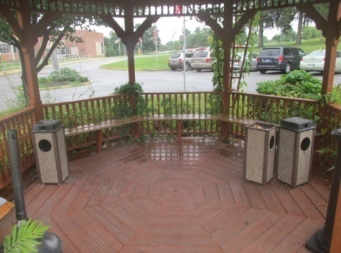
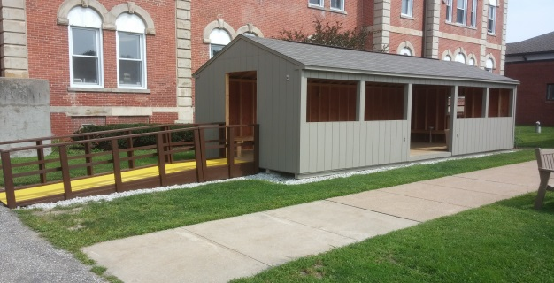
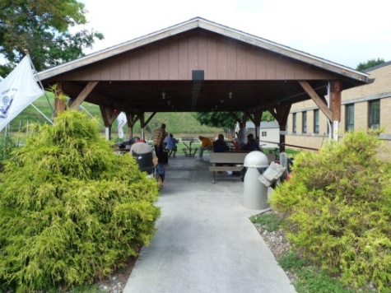
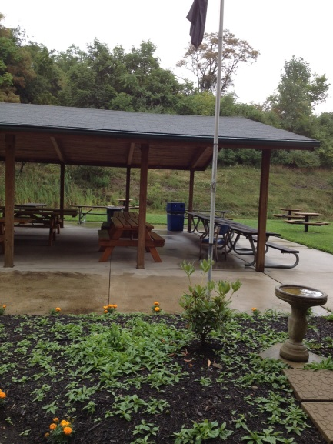
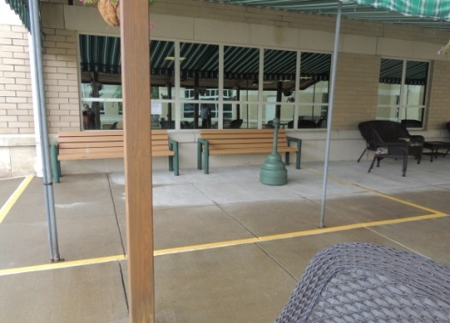
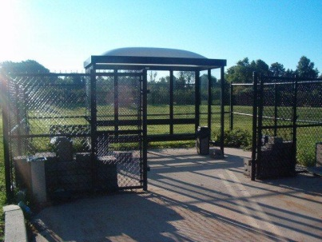
BUREAU OF VETERANS’ HOMES
Smoking in the State Veterans Homes
The main change to the policy surrounds the indoor smoking of our Personal Care residents within the SVH. The indoor smoking rooms will be closed and those residents will utilize outdoor smoking areas that meet policy guidelines, for example; measure of protection from environment, located 50 feet from common entrance, windows, or ventilation system. All SVH’s have designated areas that meet these requirements as you can see from the below images.
As of 31 Aug 14
> community > commonwealth
> country

Slide 29
BUREAU OF VETERANS’ HOMES
Smoking in the State Veterans Home
The percentage of smokers in the SVH is a much smaller population than their
non-smoking counterparts.
Total census across all six Veteran homes 1414
Total resident that smoke 92
Percentage of residents that smoke 6.5%
Skilled nursing census 1101
Skilled nursing residents that smoke 43
Percentage of skilled residents that smoke 3.9%
Personal care census 310
Personal care residents that smoke 49
Percentage of personal care residents that smoke 15.8%
As of 31 Aug 14
> community > commonwealth
> country

Slide 30
BUREAU OF VETERANS’ HOMES
Smoking in the State Veterans Home
The Departments website clearly indicates that the State Veterans Homes are smoke free. During the admission process the Veteran is made aware that the SVH is a non-smoking health care facility. Smoking cessation programs are offered to the Veteran during the initial application process. If the Veteran indicates they are not interested in quitting smoking, they are at that time not considered for admission.
In the past year there have been 10 Veterans that have decided not to enter into the State Veterans Home related to their choice to continue smoking.
As of 31 Aug 14
> community > commonwealth
> country

Slide 31
Mr. Brian Natali
Programs and Reports Briefing

Slide 32
PERSIAN GULF BONUS PROGRAM SUMMARY
EMERGENCY ASSISTANCE
$0
Lapse $0
Projected Expenditures
$10,000
Expended $16,289
18 Claimants
on the program
305 Claimants
229 Claimants
20 Claimants Projected
As of 26 Aug 14
> People > Processes
> Technology
> community > commonwealth
> country

Slide 33
PERSIAN GULF BONUS PROGRAM SUMMARY
VETERANS TEMPORARY ASSISTANCE
$400,000
Lapse $0
Projected Expenditures
$19,242
Expended $35,531
15 Claimants
on the program
400 Claimants Projected
As of 26 Aug 14
> People > Processes
> Technology
> community > commonwealth
> country

Slide 34
PERSIAN GULF BONUS PROGRAM SUMMARY
PARALYZED VETERANS PENSION
As of 15 Jan 14
As of 21 AUG 14
> People > Processes
> Technology
> community > commonwealth
> country

Slide 35
PERSIAN GULF BONUS PROGRAM SUMMARY
BLIND VETERANS PENSION
$222,000
Lapse $0
Projected Expenditure
$171,150
Expended $50,850
116 Claimants
119 Claimants
121 Claimants Projected
As of 19 Aug 14
> People > Processes
> Technology
> community > commonwealth
> country

Slide 36
PERSIAN GULF BONUS PROGRAM SUMMARY
EDUCATIONAL GRATUITY
$101,000
Lapse 0
Projected Expenditure $101,000
Expended $0
0 claimants on the program
As of 15 Jan 14
91 Claimants
104 Claimants
100 Claimants Projected
As of 19 Aug 2014
> People > Processes
> Technology
> community > commonwealth
> country

Slide 37
PERSIAN GULF BONUS PROGRAM SUMMARY
DISABLED VETERANS TAX EXEMPTION PROGRAM
As of 15 Jan 14
As of 19 Aug 2014
> People > Processes
> Technology
> community > commonwealth
> country

Slide 38
PERSIAN GULF BONUS PROGRAM SUMMARY
DISABLED VETERANS’ RETX PROGRAM
As of 15 Jan 14
*591 Applications Received since May 17, 2014
As of 19 Aug 2014
MAY 14
> People > Processes
> Technology
> community > commonwealth
> country

Slide 39
PERSIAN GULF BONUS PROGRAM SUMMARY
PERSIAN GULF VETERANS BENEFIT PROGRAM
Total Applications: 10,639
Payments Sent: 8,330
Total Payments: $3,536,912.50
Average Payment: $424.60
Average Processing Time: 4.61 days
As of 15 Jan 14
As of 19 Aug 2014
> People > Processes
> Technology
> community > commonwealth
> country

Slide 40
PERSIAN GULF BONUS PROGRAM SUMMARY
MILITARY FAMILY RELIEF ASSISTANCE PROGRAM
OVERALL MFRAP CONTRIBUTIONS - FY 2005 THRU AUG 2014
TOTAL PRIVATE CONTRIBUTIONS | $ 108,658.00
DEPT OF REVENUE - PIT DONATIONS | $ 1,386,880.94
TOTAL ALL CONTRIBUTIONS - PRIVATE & PIT DONATIONS | $ 1,495,538.94
APPROVED GRANT APPLICATION PAYMENTS | $ 516,201.58
ACCOUNT BALANCE | $ 979,337.36
As of 15 Jan 14
> People > Processes
> Technology
As of 16 Aug 2014
> community > commonwealth
> country

Slide 41
Mr. Robert Gray
PA War Veterans Council
Legislative Committee Briefing

Slide 42
LEGISLATIVE COMMITTEE ROLE
Develop legislative goals for the PA War Veterans Council (PWVC)
Review veteran-related legislation introduced in the legislature
Advise the PA War Veterans Council on its positions regarding introduced legislation
Advocate for effective veterans legislation and against harmful legislation
Inform the State Veterans Commission the PWVC’s legislative activities
Recommend legislative positions to the State Veterans Commission
Work with the DMVA Legislative Office where there are common goals and objectives
Advise the legislators on the crafting of new legislation
As of 20 AUG 14
> community > commonwealth
> country
As of 20 AUG 14
> community > commonwealth
> country

Slide 43
RESHAPING
PREMISE
A legislative act should be the last resort for change, not the first
Cultural transformation (education) of both the executive and legislative branches on the valid needs of veterans, as opposed to the National Guard, is needed
Access to state services can be threatened by misunderstandings about the Department of Veterans Affairs’ roles and missions and limitations
As of 20 AUG 14
> community > commonwealth
> country
As of 20 AUG 14
> community > commonwealth
> country

Slide 44
RESHAPING (Cont.)
A PROACTIVE PROCESS
Define a need and develop a concept to satisfy the need, as opposed to writing legislation itself
Work with OVA to determine if the Administration can satisfy the need through regulatory changes and/or executive orders
If not, advise House and Senate Veterans Affairs and Emergency Preparedness Committees on legislation
Request the assistance of and work with other special interest associations, such as AARP
Report progress to the PWVC membership – both successes and failures; post on electronic media
As of 20 AUG 14
> community > commonwealth
> country
As of 20 AUG 14
> community > commonwealth
> country

Slide 45
AGENDA
A PROPOSED AGENDA FOR THE YEAR
Enact an in-state tuition residency waiver for honorably discharged veterans (similar to that currently allowed for active duty military) to support the Post 9/11 GI Bill’s purposes and use – to the benefit of Pennsylvania’s future growth
Examine and enact pragmatic solutions towards employment of veterans transitioning to civilian life – make Pennsylvania the exemplar state
Revise the Veterans Trust Fund legislation/regulations to ensure management, accountability, sustainment, transparency – to the benefit of donors and veterans
Investigate a banking industry Better Choice Loan law that replicates the Credit Union industry’s – to the benefit of Pennsylvania’s citizens
As of 20 AUG 14
> community > commonwealth
> country
As of 20 AUG 14
> community > commonwealth
> country

Slide 46
Mr. Larry Wade
Liberty War Bird Association

Slide 47
MISSION STATEMENT
Provide Vietnam veterans with a link to their past by offering an opportunity to experience the excitement of flying in a “Huey” again
Educate other vets, pilots, and the public about the unique historic role played by the Huey in the Vietnam conflict.
Ensure the legacy of service by both the aircraft and the veterans that flew in them is not forgotten.
As of 20 AUG 14
> community > commonwealth
> country
As of 20 AUG 14
> community > commonwealth
> country

Slide 48
WHO WE ARE
Jim Haga, President of LWBA, flew Huey “slicks” and gunships in Vietnam with the 155th AHC in support of the US 4th and 25th Infantry Divisions, 5th Special Forces, 23rd ARVN and the ROK Tiger Divisions.
He is the recipient of 37 Air Medals, Air Medal with “V” for valor, the Army Commendation Medal, the Viet Nam Cross of Gallantry w/ Palm, the Army Aviator Badge and 7 other medals, ribbons and Unit Citations
He is now the Chief Instructor Pilot at Dutch Country Helicopters at the Lancaster Airport.
As of 20 AUG 14
> community > commonwealth
> country
As of 20 AUG 14
> community > commonwealth
> country

Slide 49
WHO WE ARE (Cont.)
Captain Pete Bohn spent 41 years in the Army, Army Reserve and Guard. He is a Master Army Aviator who flew Cobra gunships in Vietnam. He flew UH-60s during Medevac missions for units operating in Iraq.
He is the recipient of 2 Distinguished Flying Crosses, the Bronze Star and 26 Air Medals as well as numerous other awards.
Col (Ret.) Chuck Bechtel spent 36 years in the Army and full-time Army National Guard. He was an infantry platoon leader in Vietnam in the 1st BN, 8th Cavalry, 1st Cavalry Division (Air Mobile).
He received the Combat Infantry Badge, Bronze Star with “V” and the Air Medal for more than 25 combat assaults in a Huey.
He is a flight instructor for gliders, single & multiengine airplanes and helicopters.
As of 20 AUG 14
> community > commonwealth
> country
As of 20 AUG 14
> community > commonwealth
> country

Slide 50
HOME BASE
The Huey will be located and maintained at Dutch Country Helicopters (DCH) at the Lancaster Airport
DCH has a long history of providing quality flight instruction for helicopter pilots. They have the expertise to maintain and fly the Huey
The Huey will travel to various shows and events around the state in support of all our veterans
As of 20 AUG 14
> community > commonwealth
> country
As of 20 AUG 14
> community > commonwealth
> country

Slide 51
HOW YOU CAN HELP
LWBA needs your help to acquire and restore a UH-1 aircraft as a flying museum
We have already located several aircraft we would like to purchase
LWBA is a 501(c)(3) so your donation is tax deductible
Your can donate any amount from $5 up to your comfort level
We need approximately $350,000 to acquire a Huey and bring it to airworthy condition.
As of 20 AUG 14
> community > commonwealth
> country
As of 20 AUG 14
> community > commonwealth
> country

Slide 52
FOUNDING MEMBER
$100=annual membership letter, invitation to all events, 10% discount on merchandise, flight pass for 1 person for 1 event per year.
$1,000=Framed Member Certificate, 15% discount on merchandise, challenge coins, flight pass for 2 at 2 events per year.
$5,000=Framed Member certificate, 20% discount on merchandise, flight pass for 4 at 5 events a year & name permanently displayed inside the aircraft.
As of 20 AUG 14
> community > commonwealth
> country
As of 20 AUG 14
> community > commonwealth
> country

Slide 53
HOW TO DONATE
Donate by credit card using PayPal
No PayPal account required
Donate on the website:
http://libertywarbirds.com
Or the Facebook page: www.facebook.com/Libertywarbird
OR
Send a check to:
Liberty War Bird Association
500 Airport Rd, Suite T
Lititz, PA 17543
As of 20 AUG 14
> community > commonwealth
> country
As of 20 AUG 14
> community > commonwealth
> country

Slide 54
FOLLOW UP
See me at the Liberty War Bird Association table
Read the LWBA brochure (handout)
Visit our Website: libertywarbirds.com
Ask questions using the Contact form
Check us out on Facebook.
Call the President, Jim Haga - 484-332-0866
As of 20 AUG 14
> community > commonwealth
> country
As of 20 AUG 14
> community > commonwealth
> country

