Slide 1
UNIT MOBILIZATIONS / TOTAL DEPLOYMENTS
ARNG Units in Theater: 51
ARNG Units at MOB/DEMOB Site: 95
ARNG Individual Mob: 16
Total ARNG Mob: 162
Total PANG Mobilized: 401
Current ANG Unit Airmen Mob: 223
Current ANG Individual Mob: 16
Total: ANG Mob: 239
As of 29JAN16
> community > commonwealth
> country
Notes:
CHANGES SINCE LAST UPDATE:
ARNG:
2IBCT: 95 pax organic to PAARNG + 1 pax MDARNG= 96 (2FORSCOM pbacks awaiting fill[S2 TFCICA and Catholic Chaplain]= 98 pax)
>MDARNG SM is T32AGR awaiting MOB order dated 5FEB16-according to NGB
32 pax for NATRO mission + 1 pback(COL Parker)= NATO 33
213th Notes:
AB 1 pax – Returned home with memo of non-prosecution. SM was not properly DEMOBed and MR is working with FT Bragg and USPFO to adjust pay and DEMOB at FTIG.
Medical:1 pax med holds. SGT Skipper is home for holiday leave, but will be returning and then transferred to a WTU closer to home. Awaiting update from unit
2/104th AVN:
18 pax in Kuwait
6 pax in Taji, Iraq
Air:
8 pax – 171st ARW
20 pax – Germany, 11th 201st RHS DET 1
112th AOS – 22 pax
Future:
171st ARW-AEF -204 pax Aludeed, Qatar

Slide 2
CURRENT MOBILIZATIONS & TOTAL DEPLOYMENTS
MDATE | MSAD | UNIT | OPN | PAX | MISSION | Projected Return Date
24SEP14 | 27SEP14 | 213 Human Resources Co PLT | WTU | 1 | Personnel Support | TBD
13OCT14 | 16OCT14 | 213 Human Resources Co PLT | OEF-KU | 1 | Personnel Support | TBD
30 JAN 15 | 01 FEB 15 | Warrior Leader Course Mobile Training Team | OEF-KU | 2 | WLC | 24 OCT 15
14 MAY 15 | 17 MAY 15 | 828th Finance | OEF-A | 25 | Financial Mgmt. Spt | 16 JUN 16
07 JAN 16 | 09 JAN 16 | 2 IBCT | KFOR | 131 | Security | 07 JAN 17
Total MOB’ed PAARNG (at HS or MOB/DEMOB site) 95
Total PAARNG Units Deployed 162
Total PANG Deployed 100
PAANG Total as of 18AUG15
As of 29 JAN 16
> community > commonwealth
> country
Notes:
ARNG:
2IBCT: 95 pax organic to PAARNG + 1 pax MDARNG= 96 (2FORSCOM pbacks awaiting fill[S2 TFCICA and Catholic Chaplain]= 98 pax)
>MDARNG SM is T32AGR awaiting MOB order dated 5FEB16-according to NGB
32 pax for NATRO mission + 1 pback(COL Parker)= NATO 33
213th Notes:
AB 1 pax – Returned home with memo of non-prosecution. SM was not properly DEMOBed and MR is working with FT Bragg and USPFO to adjust pay and DEMOB at FTIG.
Medical:1 pax med holds. SGT Skipper is home for holiday leave, but will be returning and then transferred to a WTU closer to home. Awaiting update from unit
2/104th AVN:
18 pax in Kuwait
6 pax in Taji, Iraq
Air:
**ANG numbers are as of 27JAN16. Defer to ANG for discrepancies in their numbers or any questions.

Slide 3
Air Guard Update
Sep 15 – Feb 16 171st ARW Aviation Package
Oct 15 – Aug 16 193rd SOW Combat Support
Mar 16 – Jun 16 201st RHS- Beyond The Horizon
Apr 16 – Dec 16 271st CBCS Combat Support
Jun 16 – Oct 16 171st ARW Aviation Package
Jul 16 – Jan 17 270th EIS Combat Support
239 Currently Deployed
As of 27 JAN 2016
> community > commonwealth
> country

Slide 4
POLICY, PLANNING AND LEGISLATIVE AFFAIRS
United States Congress
Pennsylvania General Assembly
House/Senate in session
National Commission on the Future of the Army has released its findings.
Patrick J. Murphy – Acting Secretary of the Army
Feb. 8 - House/Senate next session day
S.R. 254 (Vulakovich) - Urges the US Congress to pass H.R. 2894, the "Caregivers Access and Responsible Expansion for All Veterans Act" or the "CARE for All Veterans Act." - Adopted
Policy/Planning
Events
Executive order on the Governor’s Advisory Council for Veterans Services (GAC-VS) to be issued in the near future.
Feb. 9 - Governor Wolf’s Budget Address
As of January 29, 2016
> community > commonwealth
> country
Notes:
Since 8 Jan 16

Slide 5
BUREAU OF VETERANS’ HOMES
Veterans’ Homes Update
Licensure Update Gino J. Merli Veterans’ Center (GMVC) - Scranton PA
GMVC remains on Provisional Licensure and is currently in compliance with all Department of Health (DOH) Regulations. The facility is awaiting another annual unannounced survey from DOH to verify compliance and then remove the provisional license. This survey will take place before June 20, 2016.
As part of the DOH recommendations a consulting company “LW Consulting” has been assigned by DOH to assist GMVC through obtaining regulatory compliance.
GMVC has made additional changes to the management team through retirements and terminations during the past several months. The new Commandant Mr. Vito Ruggiero has identified the hiring of a new Deputy Commandant and Director of Nursing both coming from the private sector with many years of experience in the skilled nursing arena. Start date for these new staff is mid February. GMVC is also contracting out for a Quality Assurance Nurse at this time while the process continues to hire a full time employee. These are the remaining key management positons that need to be filled for the home.
As of 31 JAN 16
> community > commonwealth
> country

Slide 6
BUREAU OF VETERANS’ HOMES
Recently Completed Construction Projects
Facility | Construction Project
PSSH | Roadway and parking area upgrade, $545,400, new parking lot and roads throughout campus, new security lighting installed
SWVC | Parking Lot, flooring, roof, and expand dining room, $3.4M, new parking lot and roads throughout, additional dining area created for resident comfort, all flooring replaced in facility Replacement of passenger elevators and instillation of service elevator, $2.8M, service elevator was built onto existing building
GMVC | Instillation of new dietary dishwasher, $150,543, this project included relocating electrical shutoff switches
SEVC | Instillation of new pumping station, $1.2M, this project will allow for the continued landscape changes at facility with the removal of water tower
As of 31 JAN 16
> community > commonwealth
> country

Slide 7
BUREAU OF VETERANS’ HOMES
Upcoming Construction Projects
Facility | Construction Project
PSSH | PCU Chapel renovations, $298,080, in the bid & award phase Renovation & general repairs, $7.7M, nursing units walls and floors resident rooms, in design phase – anticipate construction in 12/2016
HVH | Refurbish heating system (Eisenhower Hall), $1.3M, scheduled construction completion in 8/2016 Demo & install freezer (Dietary Bldg), $230,019, pending initial job conference & execution of construction Tunnel abatement, $1.5M, bid phase open date: 01/20/2016 Feasibility study & PNA, $500,000, draft submission in 2/2016 & final submission in 4/2016. Replacement of roof (Admin Bldg) & electrical upgrades (AH), $1M, pending delegation approval from DGS.
SEVC | Emergency generators, $2.4M, In process now scheduled construction completion in 10/2016
As of 31 JAN 16
> community > commonwealth
> country

Slide 8
BUREAU OF VETERANS’ HOMES
Upcoming Construction Projects Continued
Facility | Construction Project
SEVC | Revisions to special locking arrangement (CLC), $180,000, pending initial job conference & execution of construction to start within 30 days Demo, road repairs, & CH upgrades, $13.3M, pending bid & award phase, project includes portions of Armory Construct new maintenance bldg., $5.4M, pending bid & award phase New ADHC Program, $4M, pending approval since 6/17/2015
GMVC | Boilers & AHUs, $833,060, scheduled construction completion 8/2016 Emergency generators, $1.7M, scheduled construction completion 8/2016 Demo & install dietary dishwasher, $150,543, scheduled construction completion 4/2016 Renovation & general repairs, $5M, design phase – anticipate construction in 10/2016, this project will require an entire nursing unit at a time to be vacated for construction
As of 31 JAN 16
> community > commonwealth
> country

Slide 9
BUREAU OF VETERANS’ HOMES
Upcoming Construction Projects Continued
Facility | Construction Project
SWVC | Emergency generators, $1.7M, scheduled construction completion 8/2016 HVAC, duct cleaning, cameras, & door, window, grill seals, $1.5M, pending initial job conference & execution of construction Replacement of boilers, $544,000, bid phase – bid open date: 2/17/16
DVVH | Emergency generators, $1.6M, scheduled construction completion 10/2016 Renovation & general repairs, $5.6M, design phase, renovate resident rooms and common areas, PCU unit will be emptied and residents moved to three other Veterans’ Homes (SEVC, HVH, PSSH) as part of this construction project – anticipate construction in 10/2016 Feasibility study – additional 48-beds, $500,000, pending approval since 7/9/2015
As of 31 JAN 16
> community > commonwealth
> country

Slide 10
Operational Imperatives
Veterans’ Day at the 100th PA Farm Show – The Event was a real success and
we are working with the Department of Agriculture to make this an annual event.
Veterans On-Line Registry - Launched on December 15th. We have enjoyed a
great response (791 as of 19 January) and will continue to develop and expand the
concept to meet our operational initiative for the Veterans Information Clearing House.
Veterans On-Line Donation – Launched on Veterans Day, 2015 providing the ability
for persons to make on-line donations to the Veterans temporary Assistance (VTA)
Program and the Military Family Relief and Assistance Program (MFRAP).
We are working on version 2 of the application to include the ability for persons to
make donations to the Pennsylvania Veterans Memorial and each of the six
State Veterans Homes.
As of 22 January 2016
> community > commonwealth
> country

Slide 11
PERSIAN GULF BONUS PROGRAM SUMMARY
VETERANS TEMPORARY ASSISTANCE
$700,000
Lapse $0
Projected Expenditures
$ 363,286
Expended $ 336,714
263 Claimants
on the program
585 Claimants
644 Claimants Projected
As of 22 JAN 2016
> People > Processes
> Technology
> community > commonwealth
> country

Slide 12
PERSIAN GULF BONUS PROGRAM SUMMARY
BLIND VETERANS PENSION
$222,000
Lapse $0
Projected Expenditure
$ 84,450
Expended $ 137,550
FY 13-14
FY 14-15
FY 15-16
116 Claimants
118 Claimants
120 Claimants Projected
As of 22 JAN 2016
> People > Processes
> Technology
> community > commonwealth
> country

Slide 13
AMPUTEE & PARALYZED VETERANS PENSION
As of 22 JAN 2016
> community > commonwealth
> country

Slide 14
PERSIAN GULF BONUS PROGRAM SUMMARY
EDUCATIONAL GRATUITY
$101,000
Lapse $0
Projected Expenditure $2,269
Expended $ 98,731,42
125 Claimants on the program
As of 15 Jan 14
104 Claimants
186 Claimants
100 Claimants Projected
As of 22 JAN 2016
> People > Processes
> Technology
> community > commonwealth
> country
Notes:
125 Students on Program as of 22 Jan 2016

Slide 15
PERSIAN GULF BONUS PROGRAM SUMMARY
DISABLED VETERANS TAX EXEMPTION PROGRAM
As of 15 Jan 14
As of 22 JAN 2016
> People > Processes
> Technology
> community > commonwealth
> country

Slide 16
PERSIAN GULF BONUS PROGRAM SUMMARY
DISABLED VETERANS’ RETX PROGRAM
As of 15 Jan 14
*202 Applications Received since Dec 19, 2015
As of 22 JAN 2016
MAY 14
> People > Processes
> Technology
> community > commonwealth
> country

Slide 17
PERSIAN GULF BONUS PROGRAM SUMMARY
PERSIAN GULF VETERANS BENEFIT PROGRAM
Total Applications: 11,781
Payments Sent: 9,149
Total Payments: $3,883,287.50
Average Payment: $424.45
Average Processing Time: 5.16 days
As of 22 JAN 2016
> People > Processes
> Technology
> community > commonwealth
> country

Slide 18
PERSIAN GULF BONUS PROGRAM SUMMARY
MILITARY FAMILY RELIEF ASSISTANCE PROGRAM
OVERALL MFRAP CONTRIBUTIONS - FY 2005 THRU Jan 22, 2016
TOTAL PRIVATE CONTRIBUTIONS | $ 116,352.43
DEPT OF REVENUE - PIT DONATIONS | $ 1,494,046.19
TOTAL ALL CONTRIBUTIONS - PRIVATE & PIT DONATIONS | $ 1,610,398.62
APPROVED GRANT APPLICATION PAYMENTS | $ 749,281.86
ACCOUNT BALANCE | $ 861,116.76
As of 15 Jan 14
> People > Processes
> Technology
As of 22 JAN 2016
> community > commonwealth
> country

Slide 19
ODAGVA / ACT 66 SUMMARY
FY 15 - 16 Claims, Compensation and Pension Summary
Year to Date Claims Submitted | Year to Date Value of Awards
11,895 | $96,504,270.00
FY 14 - 15 Claims, Compensation and Pension Summary
Year to Date Claims Submitted | Year to Date Value of Awards
22,473 | $219,260,065.00
As of 31 January 16
> community > commonwealth
> country

Slide 20
OUTREACH ENGAGEMENTS
Outreach Statistics
 | 1st Qtr | 2nd Qtr | 3rd Qtr | 4th Qtr | Year to Date
Outreach Events Supported | 34 | 27 | 4 | 0 | 65
Mobile Outreach Van Events | 26 | 21 | 0 | 0 | 47
Veteran Interactions | 968 | 683 | 114 | 0 | 1,765
Claim referrals to County Directors and Service Organizations | 258 | 294 | 36 | 0 | 588
Legislator Attended Events | 12 | 14 | 0 | 0 | 26
Notes Two outreach vans are operational and supporting outreach events Upcoming Events – February Legislative Events – Congressman Boyle’s Veteran Service Day Events – Monthly Outreach at Cabela’s – Monthly Outreach at Gander Mountain – Brookhaven Outreach to Veterans Legislators Attending Events – None
As of 31 January 16
> community > commonwealth
> country

Slide 21
VETERANS’ TRUST FUND
Revenue | Since Last Meeting | SFY 15-16 | Cumulative Total
Checkoff & Donations | $37,482.00 | $859,634.00 | $3,322,813.00
HOV License Plate | $15.00* | $1,650.00 | $34,485.00
PA Monuments License Plate | $23.00* | $2,553.00 | $12,742.00
Interest | $0.00 | $1,805.00 | $7,864.00
Disbursements
VTF Grants | $0.00** | $0.00 | $932,860.00
VTA | $19,897.00 | $336,714.00 | $1,036,333.00
PENN DOT Costs | $0.00*** | $0.00 | $388,000.00
Total number of HOV License plates sold since last meeting = 1 (Total since inception = 2,299)
*Total number of PA Monuments License plates sold since last meeting = 1 (Total since inception =554)
**Awards and distribution of funds are contingent upon the completion of a fully executed grant agreements
*** PENNDOT PAYMENT/INVOICING – DMVA has Agreed to pay $194,000/FY over four years. Current Balance is $488,000. DOT will issue invoices at the beginning of April for Annual Payments. (Total Cost was 966,000.00)
As of 31 January 2016
> community > commonwealth
> country

Slide 22
THE PENNSYLVANIA MILITARY MUSEUM: A RENAISSANCE
By
John Stevens and Al Turgeon
Board of Directors
FRIENDS OF THE PENNSYLVANIA
MILITARY MUSEUM
5 February 2016

Slide 23
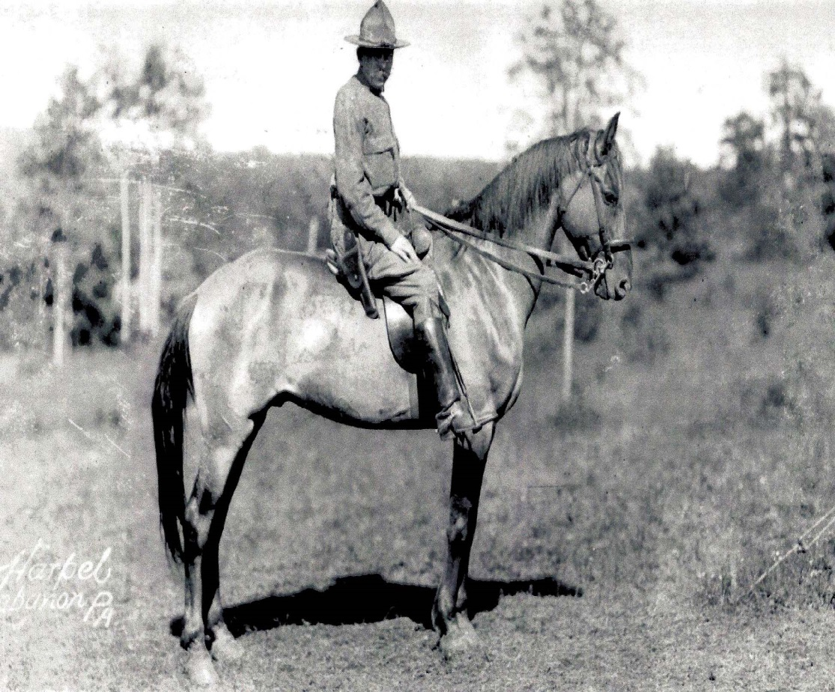
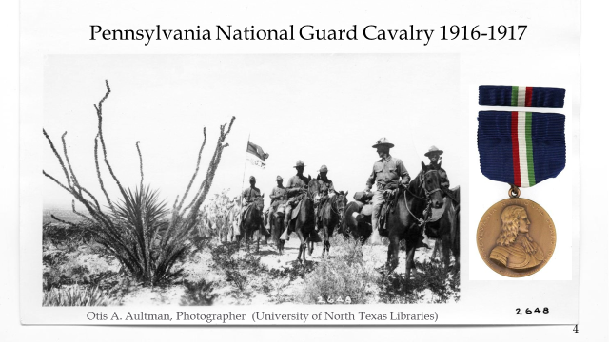
1st Lieutenant Theodore Boal organized & equipped a mounted machine gun troop in May 1916
Mustered with 1st PA Cavalry Regt for Mexican border service, Fall & Winter 1916-1917
World War I service as Co. A, 107th Machine Gun Bn

Slide 24
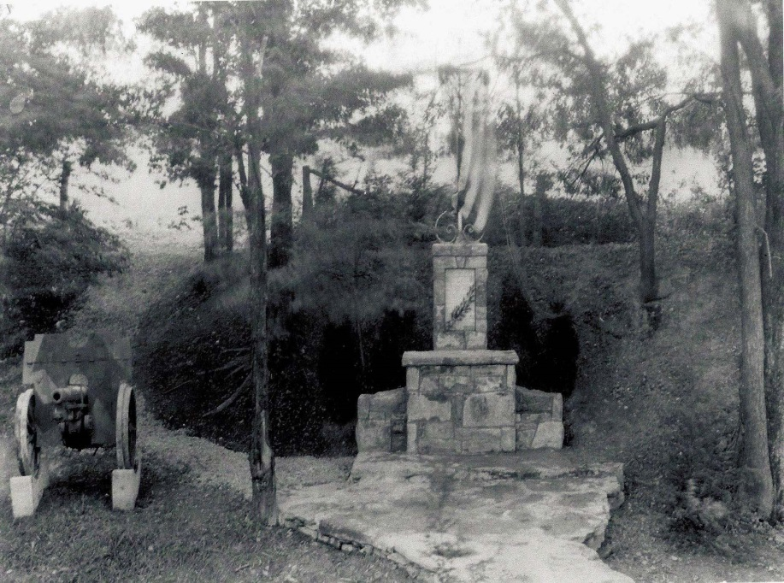
MUSEUM & SHRINE OF THE 28TH DIVISION
Shrine of the 28th Division ca. 1919
Officers’ Club and Museum ca. 1924

Slide 25
TRANSITIONS
1931 - Property sold to Adjutant General’s Office
1945 - PA Historical & Museum Commission created
1957 - PHMC assumes administrative control of site
1968 - Museum constructed – “The Trench” exhibit
1991 - ”Friends”organized
2005 - Museum opens after 2 year renovation -
2008 – Budget & staffing cuts

Slide 26
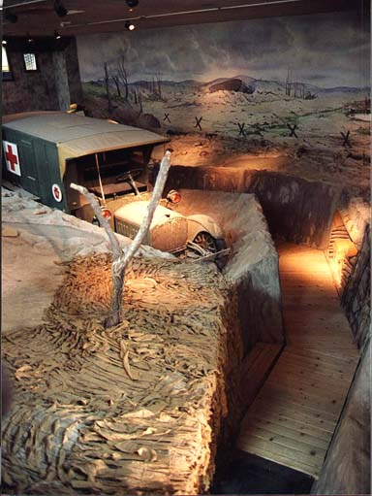
1968 EXHIBIT:The TRENCH
Complete with dugouts, bunkers, barbed wire, vehicle, artifacts, sound & lighting effects.
An historically inaccurate “environmental” exhibit, it immersed visitors in the sights and sounds of WWI life.
Museum’s primary focus: Spanish American War through World War I.

Slide 27
Pennsylvania Military museum & shrine of the 28th Division, aef

Slide 28
Shrine of the 28th Division, WWI(AEF), wwii, 2nd Bde Cbt Tm (Iraq)

Slide 29
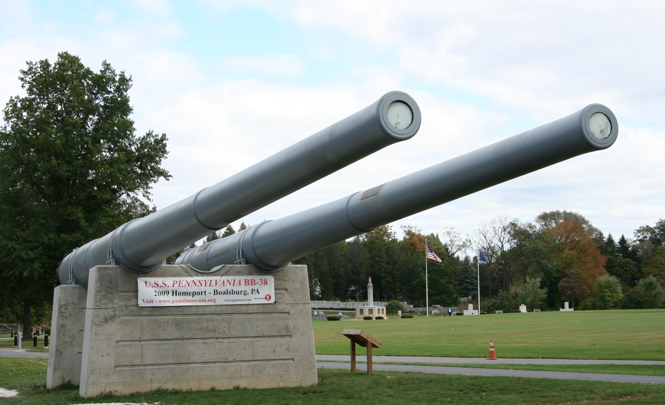
U.S.S. PENNSYLVANIA’s 14” GUNS

Slide 30
Administration, Management and Finance
The PA Historical & Museum Commission
The PA Military Museum One of 13 PHMC Administered Sites
Friends of the PA Military Museum, a 501(c)(3) Assist PHMC financially and otherwise in the development & support of the Museum
Notes:
-

Slide 31
MISSION and VISION
The Museum’s mission is to educate the public regarding the actions of Pennsylvanians in United States military history from the start of Penn’s Colony to its principal focus from the Spanish American war to the present.
The Museum’s vision is be the premier institution to tell the story of Pennsylvania’s veterans and to honor their service to Country, Commonwealth, and Community.

Slide 32
A RENAISSANCE: Disrupting the Status Quo
Strategic plan (2016-2020) expands mission to:
Honor the contributions of Pennsylvanians who served in the Army, Navy, Marine Corps, Air Force, Coast Guard & Merchant Marine.
Recognize the contributions of families of those who served, civilians, industry and other segments of private & public sectors.
A $3 million commitment by PHMC to develop a storyline, design, fabricate & install the first new exhibit since 1968.

Slide 33
AUDIENCE GOALS
Cognitive: Increase visitors’ knowledge, information recall, conceptual understanding; ability to analyze and synthesize information and reach new conclusions.
Affective: Affect a visitors’ attitudes and appreciation of what military service means to vets and their families and friends.
Behavioral: Visitors will support the Museum through return visits; Friend’s memberships, donations, sponsorships, bequests; encouraging others to visit; and support organizations that serve veterans and their needs.

Slide 34
COMMUNITY OF INTEREST
The Pennsylvania State Veterans Commission
The Department of Military and Veterans Affairs
Pennsylvania Military Museum and its Friends
We ask you to join with us to make our Museum the premier institution to tell the story of Pennsylvania’s veterans.
We invite you to convene your 8 April Commission meeting at the Military Museum.

Slide 35
NEXT MEETING
Friday, April 8, 2016 at 10:00AM
Arrowheads Community Club
Fort Indiantown Gap
Annville, PA 17003
As of 29 JAN 2016
> community > commonwealth
> country

