Slide 1
CURRENT AND FUTURE UNIT MOBILIZATIONS
ARNG Unit Soldiers in Theater: 51
ARNG Individual Mob: 16
Total ARNG Mob: 67
Total PANG Mobilized: 233
Current ANG Unit Airmen Mob: 157
Current ANG Individual Mob: 9
Total: ANG Mob: 166
As of 31DEC15
> community > commonwealth
> country
Notes:
ARNG: DET 1 2-104th 24 pax
828th FI 25 pax
Air:
193d SOW-55 pax
111th ATKW 102 pax
Indiv. Mobs 9 pax

Slide 2
CURRENT MOBILIZATIONS & TOTAL DEPLOYMENTS
PAARNG Current Deployments
MDATE | MSAD | UNIT | OPN | PAX | MISSION | Projected Return Date
14 MAY 15 | 17 MAY 15 | 828th Finance | OEF-A | 25 | Financial Mgmt. Spt | 16 JUN 16
30 SEP 15 | 03 OCT 15 | DET 1 2/104th | OEF-KU | 24 | MEDEVAC | 02 NOV 16
Various Individual MOB Soldiers |  |  |  | 18 | Various Missions | TBD
Total PAARNG Deployed: 67
Total PANG Deployed 233
As of 31DEC15
> community > commonwealth
> country
Notes:
**ANG numbers are as of 24 SEP 15. Defer to ANG for discrepancies in their numbers or any questions.

Slide 3
Air Guard Update
Sep 15 – Feb 16 171st ARW Aviation Package
Sep 15 – Feb 16 193rd SOW Combat Support
Jan 16 – Jun 16 193rd SOW Combat Support
Mar 16 – Jan 17 271st CBCS Combat Support
Jun 16 – Oct 16 171st ARW Aviation Package
Jun 16 – Jan 17 270th EIS Combat Support
166 Currently Deployed
As of 28 DEC 2015
> community > commonwealth
> country

Slide 4
Lebanon VA Medical Center
Behavioral Health and Sciences
Transformation of Recovery Programs
Mr. Robert W. Callahan, Jr.
Director

Slide 5
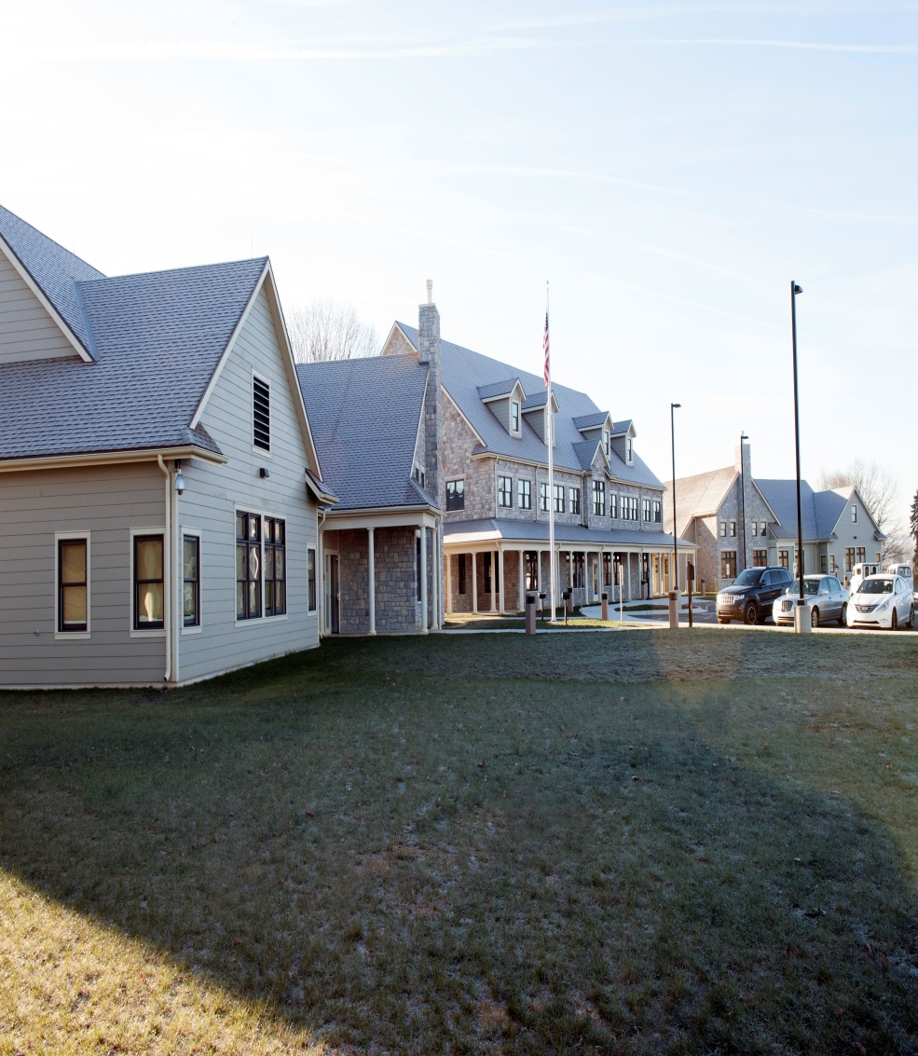
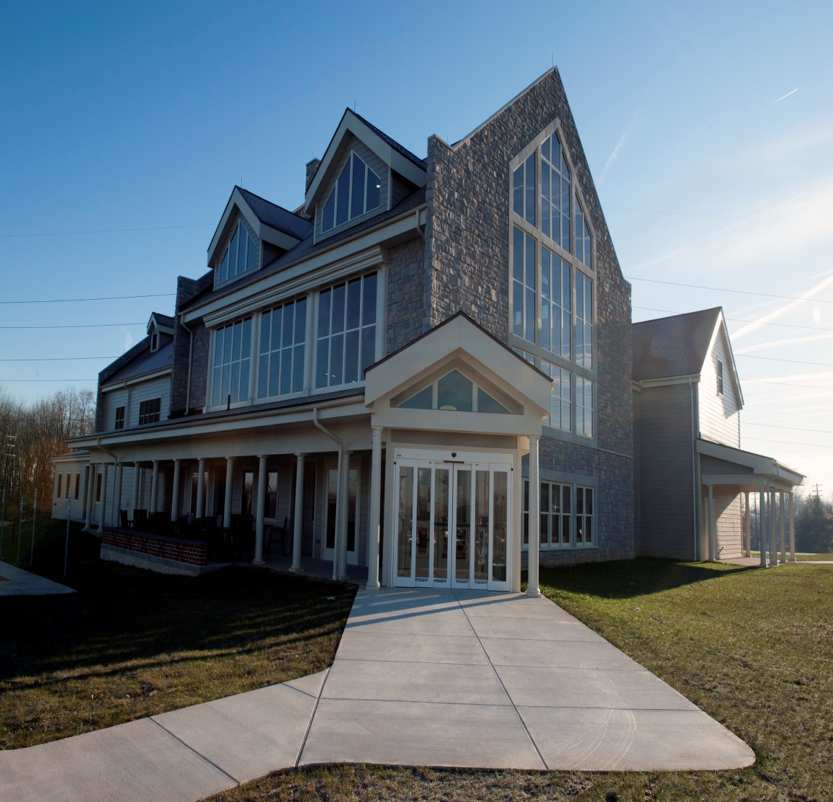
CENTER FOR VETERAN ENTERPRISE
RESIDENTIAL RECOVERY CENTER

Slide 6
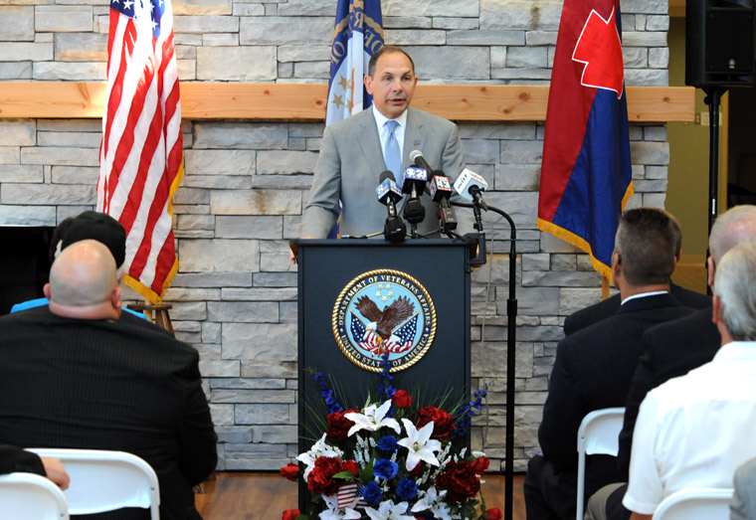
Secretary of Veterans Affairs, Robert A. McDonald addressed the Veterans and the public at the Lebanon VA Medical Center’s ribbon cutting ceremony of the Center for Veteran Enterprise on August 28, 2015.

Slide 7
Center for Veteran Enterprise & Residential Recovery Center
Lebanon VA Medical Center
Vision/Goals
Center for Veteran Enterprise (CVE)
Bring VA and community resources together in one location to optimize treatment, training and employment opportunities
Accessible and comfortable location for Veterans to work toward successful integration in the community
Residential Recovery Center (RRC)
To provide world class Veteran-centered residential recovery for substance use disorders and other behavioral health conditions

Slide 8
Center for Veteran Enterprise
Lebanon VA Medical Center
Programs Located in the CVE
1. Vocational Rehabilitation Services: An array of employment and education information and services designed to assist Veterans in returning to community employment.
2. MHICM (Mental Health Intensive Case Management): Case managers assist Veterans with serious mental illness attain their highest level of functioning during their recovery process. Staff provides advocacy, support, encouragement and professional mental health services.
3. PRRC (Psychosocial Rehabilitation and Recovery Center): Learning environment that nurtures, empowers and inspires Veterans with serious mental illness to develop hope, validate strengths, build social supports, learn skills and enhance community integration.

Slide 9
Center for Veteran Enterprise & Residential Recovery Center
Lebanon VA Medical Center
Community Partners
Harrisburg Area Community College (HACC)
Career guidance
Offer classes on site
Financial aid assistance
Enhance existing relationship
Offer remote classes using CCTV
Pennsylvania Career Link
On site employment preparation classes
Career exploration opportunities on site
Enhance existing Veteran services
Job and career fairs
Office of Vocational Rehabilitation (OVR)
Enhances existing Veterans services
Provides information and assistance on trainings
On-site opportunities for career, education and employment awareness

Slide 10
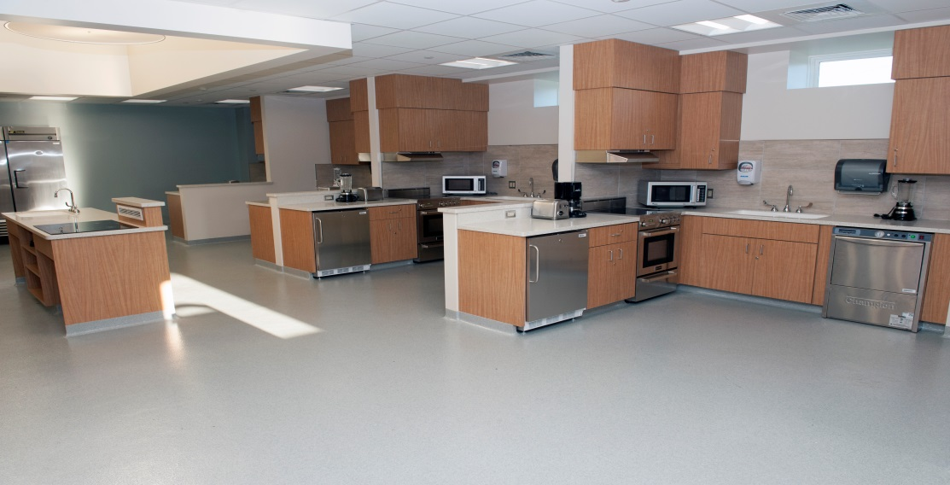
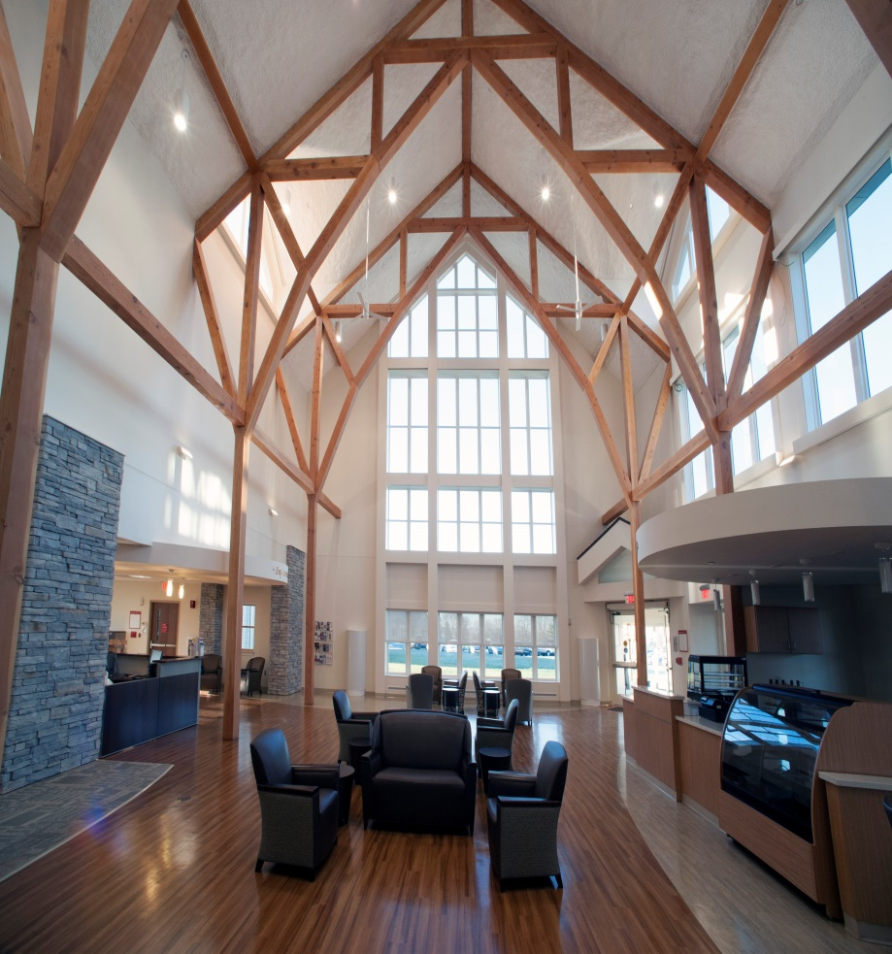
The Center for Veteran Enterprise offers the opportunity for Veterans, staff, and community partners to collaborate and plan for the individual success of each Veteran.
Training Kitchen:
• Staff can offer basic cooking and living skills
• Veterans cook with produce from their gardens
• Local college to provide culinary classes
The Center’s training kitchen will offer classes in basic cooking and nutrition, as well as more advanced cooking options.
The common area is a large, versatile space, which includes a café, where Veterans can study or relax in a peaceful environment. It also can be transformed into a venue for a job fair or a career planning symposium. The building includes a computer lounge for Veterans to access education, training, and employment opportunities. There are also three large classrooms and nine consultation rooms.

Slide 11
Residential Recovery Center
Lebanon VA Medical Center
Overview of the Residential Recovery Center (RRC) - 2014
43 bed state-of-the-art facility for substance use/major mental health disorders and other psychosocial issues
90% of Veterans have substance use disorders
40% have post-traumatic stress disorder (PTSD)
Closely collaborate with PTSD Clinical Team in outpatient clinic
60% are homeless
Integrated with VA Homeless programs
25% have recent involvement with the justice system
Collaboration between VA Justice Outreach office, State Parole and local Veteran’s court systems

Slide 12
Residential Recovery Center
Lebanon VA Medical Center
Residential Recovery Center (RRC) - continued
Vast majority of Veterans are unemployed
Emphasis on vocational retraining
Compensated Work Therapy (working within VA medical center)
Job placement in community
Pursue educational goals
Learn and practice money management skills while staying in stable environment and saving for housing needs at discharge
Wide array of medical needs are also addressed

Slide 13
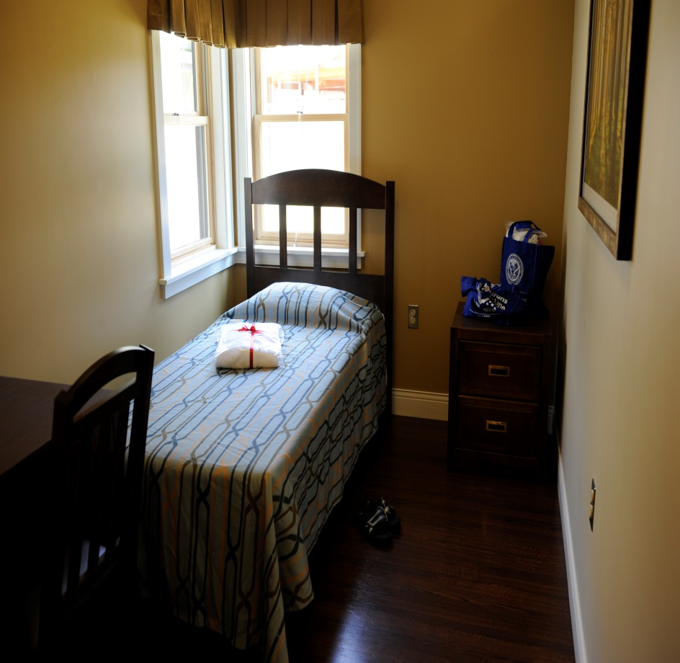
The Residential Recovery Center provides a home-like atmosphere where the residents can enjoy living and dining spaces along with areas for both indoor and outdoor recreational activities. Classrooms are available for daily group sessions which are led by staff on a variety of educational and therapeutic topics.

Slide 14
Questions?

Slide 15
POLICY, PLANNING AND LEGISLATIVE AFFAIRS
United States Congress
Pennsylvania General Assembly
House in session / Senate returns Jan. 11, 2016
MILCON and Veterans Affairs Appropriations – H.R. 2029
Enacted P.L. 114-113
House/Senate session – to be announced
SR 171 (Argall) Resolution directs the Legislative Budget and Finance Committee to conduct a study relating to the feasibility and cost-effectiveness of utilizing privately owned veterans care facilities to augment the Commonwealth's six State-owned veterans care facilities. Requires the committee to report its findings and recommendations to the Senate.
Policy/Planning
Events
Executive order on the Governor’s Advisory Council for Veterans Services (GAC-VS) to be issued in the near future.
Pennsylvania Farm Show – January 9-16, 2016
As of December 28, 2015
> community > commonwealth
> country
Notes:
Since 2 Oct 15

Slide 16
POLICY, PLANNING AND LEGISLATIVE AFFAIRS
Enacted State Legislation
Act | Description
Act 50 (HB 175/Goodman) | Amends the Persian Gulf Conflict Veterans Benefit Act further providing for application for compensation by changing the deadline for filing applications from August 31, 2015, to August 31, 2018, and extends authorization for Commonwealth indebtedness to December 31, 2019. Further requires the Department of Military and Veterans Affairs to submit annual reports to the chairmen and minority chairmen of the Senate and House Appropriations Committees.
Act 56 (SB 890/Blake) | Act designating the bridge carrying State Route 6011 (Harrison Avenue) over Roaring Brook in the City of Scranton, Lackawanna County, as the Colonel Frank Duffy Memorial Bridge.
Act 71 (HB 735/Helm) | Act designates a bridge on that portion of State Route 147 over the Wiconisco Creek, Millersburg Borough, Dauphin County, as the Private Warren Snyder Memorial Bridge.
Act 82 (SB 1045/Vulakovich) | Amends Title 51 (Military Affairs) adding a new section providing for Character of Discharge. Provides that whenever a character of discharge is a prerequisite to eligibility for receiving a benefit under Title 51, an individual is required to have received a discharge from service under conditions other than dishonorable.
Act 83 (SB 1046/Vulakovich) | Amends Title 51 (Military Affairs) standardizing the process for promotion on the retired list of the Pennsylvania National Guard. A retiree's application for promotion shall be reviewed and approved in accordance with applicable regulations. The Adjutant General retains final approval authority. Effective in 60 days.
As of December 28, 2015
> community > commonwealth
> country
Notes:
The following legislation was signed into law by Governor Wolf since the last SVC meeting on October 2, 2015. Please note that the ones in bold are bills we worked on.

Slide 17
POLICY, PLANNING AND LEGISLATIVE AFFAIRS
Enacted State Legislation (Continued)
Act | Description
Act 87 (HB 1279/Keller) | Act designating a section of Christopher Columbus Boulevard between Oregon Avenue and Washington Avenue in the City of Philadelphia, Philadelphia County, as the William J. Guarnere and Edward "Babe" Heffron Memorial Boulevard; designating a portion of US Route 222 in Lancaster County as the Senator Noah W. Wenger Highway; designating a bridge on that portion of State Route 1029 over the Tunkhannock Creek, Nicholson Township, Wyoming County, as the Jody Allen Cron Memorial Bridge; designating Exit 113, State Ramp 8001, from Interstate 79 onto State Route 208, in Springfield Township, Mercer County, as the Lieutenant Colonel Michael E. McLaughlin Veterans Ramp; designating a bridge on that portion of State Route 88 over Muddy Creek, Cumberland Township, Greene County, as the Army Specialist Richard W. Kowalewski, Jr., Memorial Bridge; and making a related repeal.
Act 89 (HB 1579/Rapp) | Act designating a bridge on that portion of State Route 62 over the Allegheny River, Tionesta Borough, Forest County, as the Lt. Col. Michael McLaughlin/AMVETS Post 113 Memorial Bridge.
As of December 28, 2015
> community > commonwealth
> country
Notes:
The following legislation was signed into law by Governor Wolf since the last SVC meeting on October 2, 2015. Please note that the ones in bold are bills we worked on.

Slide 18
POLICY, PLANNING AND LEGISLATIVE AFFAIRS
Enacted Federal Legislation
Law | Description
P.L. 144-58 | The “Department of Veterans Affairs Expiring Authorities Act of 2015” extends the authorization for numerous Veterans Affairs programs related to health care, benefit services, homelessness programs, and more.
P.L. 114-62 | The “Gold Star Fathers Act of 2015,” amend chapter 21 of title 5, United States Code, to provide that fathers of certain permanently disabled or deceased veterans shall be included with mothers of such veterans as preference eligible for treatment in the civil service.
P.L. 114-75 | The “Wounded Warriors Federal Leave Act of 2015," The Act adds section 6329 to title 5, United States Code. This new section provides a separate new leave category, to be known as “disabled veteran leave,” to any new Federal employee who is a veteran with a service-connected disability rated at 30 percent or more for purposes of undergoing medical treatment for such disability for which sick leave could regularly be used. Disabled veteran leave is available during the first 12 months of employment and may not exceed 104 hours. Disabled veteran leave not used during the first 12 months of employment may not be carried over to subsequent years and will be forfeited.
P.L. 114-68 | The “Border Jobs for Veterans Act of 2015,” To actively recruit members of the Armed Forces who are separating from military service to serve as Customs and Border Protection Officers.
P.L. 114-113 | The “Military Construction and Veterans Affairs, and Related Agencies Appropriations Act, 2016.” The Military Construction and Veterans Affairs and Related Agencies Appropriations Act, 2016 provides FY2016 appropriations to the Department of Defense (DOD) for military construction, military family housing, the U.S. share of the North Atlantic Treaty Organization Security Investment Program, and base closures and realignments. The bill also provides appropriations to the Department of Veterans Affairs (VA) for veterans benefit and health care programs, Departmental Administration, and the National Cemetery Administration.
As of December 28, 2015
> community > commonwealth
> country
Notes:
The following legislation was signed into law by President Obama since the last SVC meeting on October 2, 2015 that is related to Veterans.

Slide 19
BUREAU OF VETERANS’ HOMES
Veterans’ Homes Update
Legionnaire’s Disease
Licensure
Construction
As of 31 DEC 15
> community > commonwealth
> country

Slide 20
Operational Imperatives
Service Member, Veteran and their families Wellness Initiative– Is presented in
partnership with the Office of Mental Health and Substance Abuse Services
(OMHSAS).
14 Hour Training Session (3 Day Course Syllabus)
MHFA (8 hours)
Effective Communication (2 Hours)
Understanding Military Culture (1 Hour)
Understanding the Challenges of Community Reintegration (1 Hour)
Wellness, Recovery and Action Plan (WRAP) (1 Hour)
Community Resource Awareness (1 Hour),
Target Audience = Community centric, Service Members, Veterans,
Family and Anyone who may interact with a Veteran.
We are currently planning to host 8 courses using a Regional approach to deliver
training throughout the Commonwealth.
As of 18 December 2015
> community > commonwealth
> country

Slide 21
Operational Imperatives
Mental Health First Aid (MHFA) – This is a continuation of our successful partnership with the Department of Human Services (DHS). Training is presented in partnership with the Office of Mental Health and Substance Abuse Services (OMHSAS).
8 Hour Mental Health First Aid Training Session
Graduates are certified as MHFA First Responders
Identify the early warning signs of behavioral health challenges and take appropriate action before our Veterans go into crisis.
Target Audience=Community centric, Service Members, Veterans, family and anyone who may interact with a Veteran.
We are currently planning to host 8 courses using a Regional approach to deliver
training throughout the Commonwealth.
As of 18 December 2015
> community > commonwealth
> country

Slide 22
Operational Imperatives
Mental Health First Aid Instructor Certification Course – We will host one, forty hour instructor certification course during the early months of 2016. This course will seat up to 30 candidates.
40 Hour Mental Health First Aid Instructor Certification Course
Graduates are certified as MHFA Instructors
Work with DMVA and OMHSAS to teach MHFA courses
throughout the Commonwealth.
Target Audience=Community centric, Service Members, Veterans, family, Corrections Officers, Teachers, Social Workers, Health Care Professionals, Community Leaders, Veteran Service Officers and anyone who may interact with a Veteran.
As of 18 December 2015
> community > commonwealth
> country

Slide 23
Veterans’ Day at the 100th PA Farm Show – DMVA and the PA Department
of Agriculture jointly sponsor this event on January 14th 2016.
The Susquehanna Room is being made available all day for use by
Veteran Service Organizations and Community Partners to
increase awareness and provide services to Veterans and
their families
A number of events are already scheduled:
DMVA Outreach Team will be on site all day
0900-1900 VSOs are invited to do presentations on the
AgConnect Careers Stage in the East hall, or in the
Susquehanna Room
1100-1200 Ag-Vet Forum Ag and Career Options for Vets
1300-1400 Army-Navy Cook-Off Competition
1500-1700 Showing and discussion of Terra Firma
There is still time for organizations to become involved if they desire.
As of 18 December 2015
> community > commonwealth
> country

Slide 24
PERSIAN GULF BONUS PROGRAM SUMMARY
VETERANS TEMPORARY ASSISTANCE
$700,000
Lapse $0
Projected Expenditures
$ 414,683
Expended $ 285,317
218 Claimants
on the program
585 Claimants
644 Claimants Projected
As of 18 DEC 2015
> People > Processes
> Technology
> community > commonwealth
> country

Slide 25
PERSIAN GULF BONUS PROGRAM SUMMARY
BLIND VETERANS PENSION
$222,000
Lapse $0
Projected Expenditure
$ 101,700
Expended $ 120,300
FY 13-14
FY 14-15
FY 15-16
116 Claimants
118 Claimants
120 Claimants Projected
As of 18 DEC 2015
> People > Processes
> Technology
> community > commonwealth
> country

Slide 26
PARALYZED VETERANS PENSION
As of 18 DEC 2015
> community > commonwealth
> country

Slide 27
PERSIAN GULF BONUS PROGRAM SUMMARY
EDUCATIONAL GRATUITY
$101,000
Lapse $0
Projected Expenditure $101,000
Expended $0
0 Claimants on the program
As of 15 Jan 14
104 Claimants
186 Claimants
100 Claimants Projected
As of 18 DEC 2015
> People > Processes
> Technology
> community > commonwealth
> country
Notes:
94 Students currently ready for payment - $ 84,112.92

Slide 28
PERSIAN GULF BONUS PROGRAM SUMMARY
DISABLED VETERANS TAX EXEMPTION PROGRAM
As of 15 Jan 14
As of 18 DEC 2015
> People > Processes
> Technology
> community > commonwealth
> country

Slide 29
PERSIAN GULF BONUS PROGRAM SUMMARY
DISABLED VETERANS’ RETX PROGRAM
As of 15 Jan 14
*598 Applications Received since Sep 23, 2015
As of 18 DEC 2015
MAY 14
> People > Processes
> Technology
> community > commonwealth
> country

Slide 30
PERSIAN GULF BONUS PROGRAM SUMMARY
PERSIAN GULF VETERANS BENEFIT PROGRAM
Total Applications: 11,781
Payments Sent: 9,149
Total Payments: $3,883,287.50
Average Payment: $424.45
Average Processing Time: 5.16 days
As of 18 DEC 2015
> People > Processes
> Technology
> community > commonwealth
> country

Slide 31
PERSIAN GULF BONUS PROGRAM SUMMARY
MILITARY FAMILY RELIEF ASSISTANCE PROGRAM
OVERALL MFRAP CONTRIBUTIONS - FY 2005 THRU DEC 18, 2015
TOTAL PRIVATE CONTRIBUTIONS | $ 114,250.43
DEPT OF REVENUE - PIT DONATIONS | $ 1,491,691.10
TOTAL ALL CONTRIBUTIONS - PRIVATE & PIT DONATIONS | $ 1,605,941.53
APPROVED GRANT APPLICATION PAYMENTS | $ 708,599.86
ACCOUNT BALANCE | $ 897,341.67
As of 15 Jan 14
> People > Processes
> Technology
As of 18 DEC 2015
> community > commonwealth
> country

Slide 32
ODAGVA / ACT 66 SUMMARY
FY 15 - 16 Claims, Compensation and Pension Summary
Year to Date Claims Submitted | Year to Date Value of Awards
9961 | $75,035,858.00
FY 14 - 15 Claims, Compensation and Pension Summary
Year to Date Claims Submitted | Year to Date Value of Awards
22,473 | $219,260,065.00
As of 31 December 15
> community > commonwealth
> country

Slide 33
OUTREACH ENGAGEMENTS
Outreach Statistics
 | 1st Qtr | 2nd Qtr | 3rd Qtr | 4th Qtr | Year to Date
Outreach Events Supported | 34 | 27 | 0 | 0 | 61
Mobile Outreach Van Events | 26 | 21 | 0 | 0 | 47
Veteran Interactions | 968 | 683 | 0 | 0 | 1,651
Claim referrals to County Directors and Service Organizations | 258 | 294 | 0 | 0 | 552
Legislator Attended Events | 12 | 14 | 0 | 0 | 26
Notes Two outreach vans are operational and supporting outreach events Upcoming Events – January Legislative Events – None Events – Monthly Outreach at Cabela’s – Monthly Outreach at Gander Mountain – Veteran’s Day at the Farm Show – Brookhaven Outreach to Veterans Legislators Attending Events – None
As of 31 December 15
> community > commonwealth
> country

Slide 34
VETERANS’ TRUST FUND
Revenue | Since Last Meeting | SFY 15-16 | Cumulative Total
Checkoff & Donations | $302,346 | $748,531 | $3,179,566
HOV License Plate | $480* | $1,650 | $34,185
PA Monuments License Plate | $575* | $2,507 | $12,190
Interest | $625 | $1,805 | $7,515
Disbursements
VTF Grants | $0.00** | $0.00 | $932,860
VTA | $103,643 | $285,317 | $937,047
PENN DOT Costs | $0.00*** | $0.00 | $388,000
Total number of HOV License plates sold since last meeting = 45 (Total since inception = 2,297)
*Total number of PA Monuments License plates sold since last meeting = 45 (Total since inception =552)
**Awards and distribution of funds are contingent upon the completion of a fully executed grant agreements
*** PENNDOT PAYMENT/INVOICING – DMVA has Agreed to pay $194,000/FY over four years. Current Balance is $488,000. DOT will issue invoices at the beginning of April for Annual Payments. (Total Cost was 966,000.00)
As of 25 Mar14
As of 31 December 2015
> community > commonwealth
> country

Slide 35
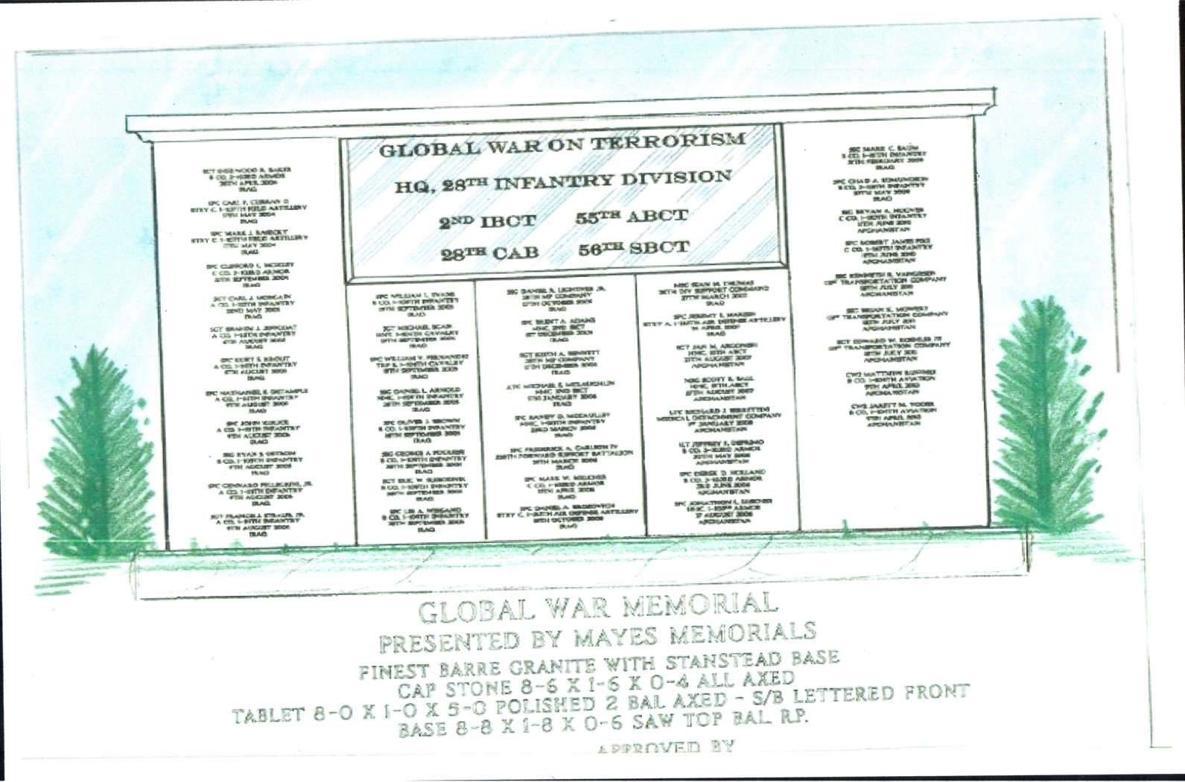
28TH ID GLOBAL WAR ON TERRORISM MEMORIAL - BOALSBURG
https://sites.google.com/site/gwotmemorialboalsburg/

Slide 36
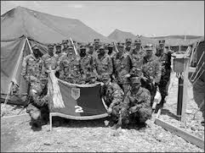
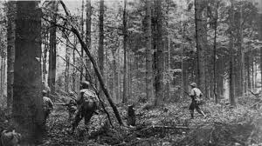
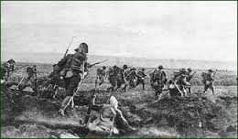
28TH ID GLOBAL WAR ON TERRORISM MEMORIAL - BOALSBURG
Financial Support
The Memorial Committee is seeking support from any and all willing donors from both the business and private sector.
The Memorial Committee is asking permission to place donation canisters at your place of business.
The Memorial Committee will monitor the canisters and collect donations on a regular basis.

Slide 37
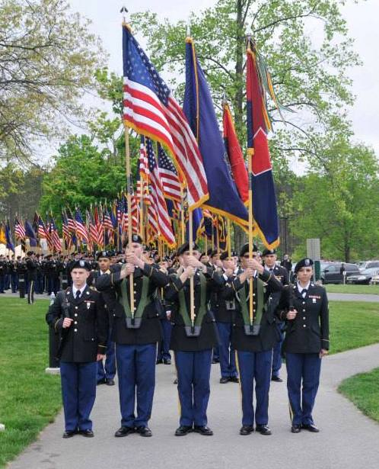
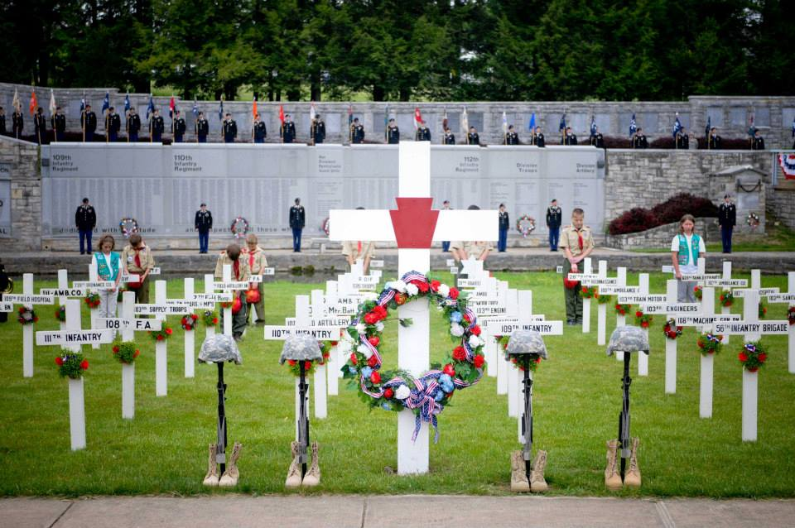
Boalsburg Memorial
Boalsburg, the birth place of Memorial Day, serves as the home to the 28th Infantry Division Shrine and Pennsylvania Military Museum. The site was first used in 1919 by the Officers of the 28th ID, when they gathered for a reunion and dedicated a simple memorial to their fallen comrades. The reunions became an annual affair, and through the years additional memorials have been added. By 1931, this portion of the historic Boal Family estate had developed into a well-established “Shrine” of the 28th ID.
In May of each year, hundreds of Soldiers, Veterans, Gold Star Families, and Citizens alike gather to honor the members of the 28th ID who have made the ultimate sacrifice in the name of freedom. The beautiful grounds of Boalsburg are dedicated to the memory of the Soldiers of the 28th Infantry Division who laid down their lives for our Country, Commonwealth, and Community.

Slide 38
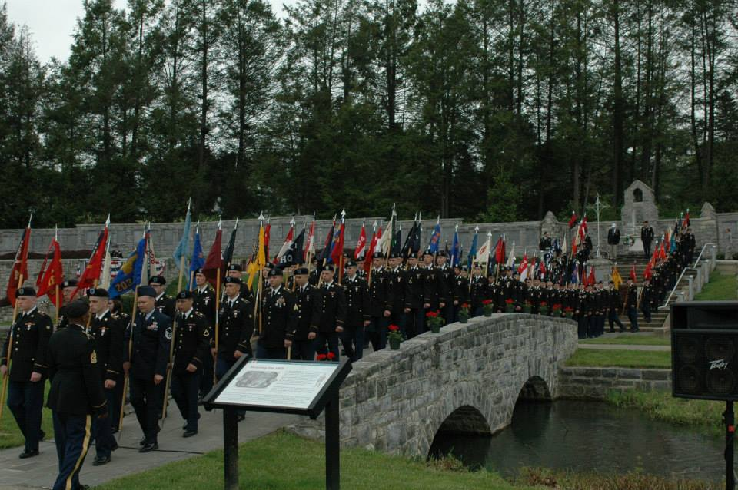
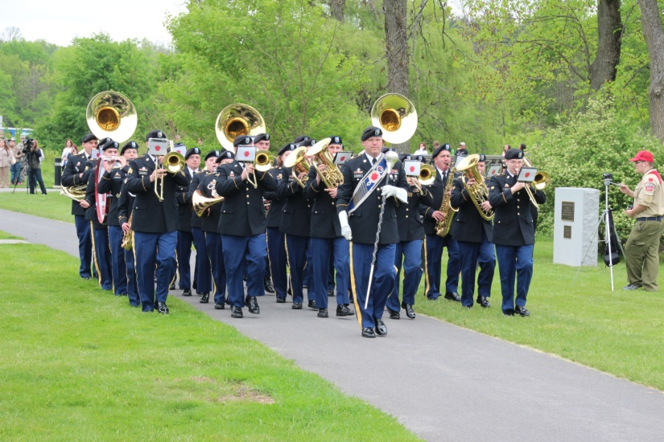
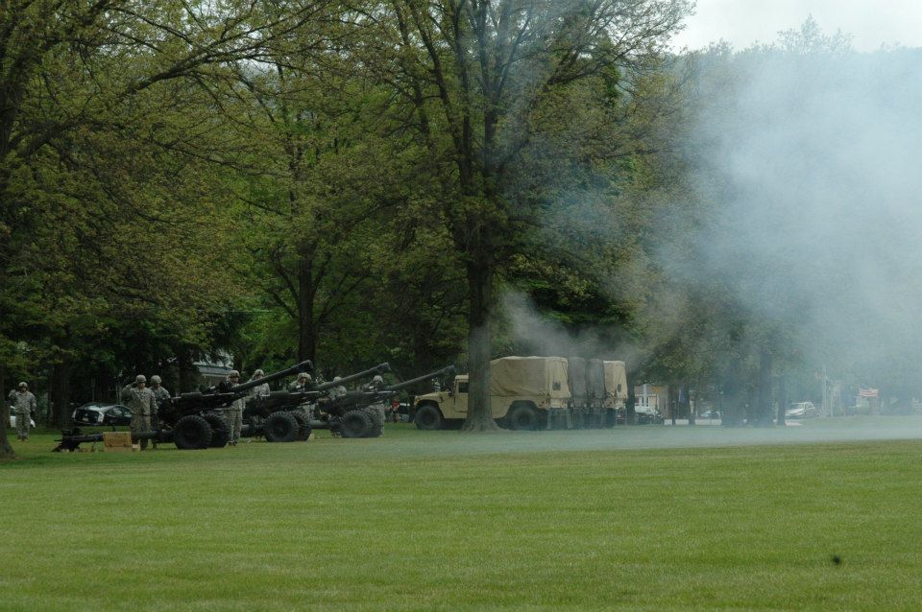
Boalsburg Memorial Service
During the Boalsburg Memorial Service, each of the units within the Division are represented with a Guidon, while every Battalion is represented with a full Color Guard.
The 28th Infantry Division band provides the musical accompaniment, and one of the Division’s distinguished firing batteries performs the full 21 gun salute.
The Boalsburg Ceremony includes recognition of the honored Gold Star Families of the service members who has made the ultimate sacrifice since September 11th, 2001.

Slide 39
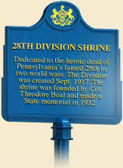
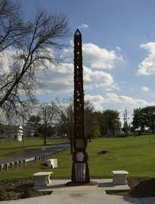
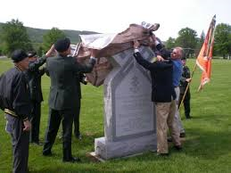
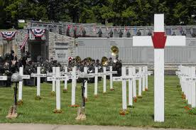
28TH ID GLOBAL WAR ON TERRORISM MEMORIAL - BOALSBURG
https://sites.google.com/site/gwotmemorialboalsburg/
Throughout history, the 28th ID has ensured the memorial remembrance of it’s Fallen Comrades in Boalsburg, Pennsylvania.
The time has come to memorialize the Fallen Soldiers of the 28th ID who served in the Global War on Terrorism.

Slide 40
28TH ID GLOBAL WAR ON TERRORISM MEMORIAL - BOALSBURG
Cost and Funding
The total cost for design, administration, and construction is $40,000.00
Fund raising will be conducted via word of mouth, stand-alone events, mailings, and on-line/social media
The Memorial Committee has established an on-line payment ability (PayPal* and Credit Card) on the Memorial Website;
Checks can be made payable to: “28th ID Memorial Fund,” and mailed to:
28th ID Memorial Committee
Attn: Clyde Brown
Building #1
1400 Calder Street
Harrisburg, PA 17103
https://sites.google.com/site/gwotmemorialboalsburg/
*Please Note That PayPal Deducts a Service Fee From Your Donation Prior to Presenting Funds to an Organization

Slide 41
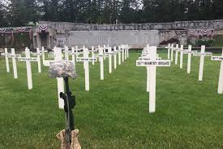
28TH ID GLOBAL WAR ON TERRORISM MEMORIAL - BOALSBURG
Criteria
Soldier must have been mobilized under authority of executive order 13223 dated 14SEP2001
Soldier must have been physically in GWOT theater at the time of death
Soldier must have been organic to 28ID,
unit shown on memorial will show unit
of assignment on mobilization orders

Slide 42
ARTIST’S RENDERING
Design and Construction by Mayes Memorials of Lemont, PA

Slide 43
28TH ID GLOBAL WAR ON TERRORISM MEMORIAL - BOALSBURG
Proposes Site at Boalsburg
28ID GWOT MEMORIAL SITE Proposed Location

Slide 44
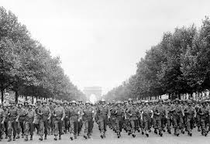
Design Information

Slide 45
Stand Alone Concept
Global War on Terrorism
SGT Sherwood R. Baker
B Co, 2-103rd Armor
26th April 2004
IRAQ
SSG Mark C. Baum
B Co, 1-111th Infantry
21th FEBRUARY 2009
IRAQ
HQ, 28th Infantry Division
SPC Carl F. Curran II
btry C, 1-107th field artillery
17th May 2004
IRAQ
SPC Chad A. Edmundson
B Co, 2-112th Infantry
27th MAY 2009
IRAQ
SPC Mark J. Kasecky
BTRY C, 1-107th Field Artillery
17th May 2004
IRAQ
2nd IBCT 55th ABCT
SSG Bryan A. Hoover
C Co, 1-110th Infantry
11th JUNE 2010
AFGHANISTAN
SPC CLIFFORD L. MOXLEY
C CO, 2-103rd Armor
25TH SEPTEMBER 2004
IRAQ
28th CAB 56th SBCT
SFC Robert James Fike
C Co, 1-110th Infantry
11th June 2010
AFGHANISTAN
SGT Carl J. Morgain
A co, 1-112th Infantry
22nd May 2005
IRAQ
SPC William L. Evans
B Co, 1-109th Infantry
19th September 2005
IRAQ
SSG Daniel R. Lightner Jr.
28th MP Company
27th October 2005
IRAQ
MSG Sean M. Thomas
28TH Div Support Command
27th March 2007
IRAQ
SSG Kenneth R. Vangiesen
131st transportation company
18th JULY 2011
AFGHANISTAN
SGT Brahim J. Jeffcoat
A co, 1-111th Infantry
6th August 2005
IRAQ
SGT Michael Egan
HHT, 1-104th Cavalry
19th September 2005
IRAQ
SFC Brent A. Adams
HHC, 2ND IBCT
1st December 2005
IRAQ
SPC JEREMY E. MARESH
BTRY a, 1-213th Air Defense Artillery
24 APRIL 2007
IRAQ
SSG Brian K. Mowery
131st transportation company
18th JULY 2011
AFGHANISTAN
SPC Kurt E. Krout
A co, 1-111th Infantry
6th August 2005
IRAQ
SPC William V. Fernandez
TRP B, 1-104th Cavalry
19th September 2005
IRAQ
SGT Keith A. Bennett
28th MP Company
11th December 2005
IRAQ
SGT Jan M. Argonish
HHC, 55TH ABcT
27th August 2007
AFGHANISTAN
SGT Edward W. Koehler III
131st transportation company
18th JULY 2011
AFGHANISTAN
SPC Nathaniel E. Detample
A co, 1-111th Infantry
9th August 2005
IRAQ
SSG Daniel L. Arnold
hhc, 1-109th Infantry
28th September 2005
IRAQ
LTC Michael E. Mclaughlin
HHC, 2ND IBCT
5th January 2006
IRAQ
MSG Scott R. Ball
HHC, 55TH ABcT
27th August 2007
AFGHANISTAN
Cw3 Matthew ruffner
B co, 1-104th aviation
9th April 2013
AFGHANISTAN
SPC John Kulick
A co, 1-111th Infantry
9th August 2005
IRAQ
SPC Oliver J. Brown
B co, 1-109th Infantry
28th September 2005
IRAQ
SFC Randy D. McCaulley
HHC, 1-110th Infantry
23rd March 2006
IRAQ
LTC Richard J. Berrettini
Medical Detachment company
1st January 2008
AFGHANISTAN
Cw2 Jarett m. Yoder
B co, 1-104th aviation
9th April 2013
AFGHANISTAN
SSG Ryan S. Ostrom
B Co, 1-109TH Infantry
9th August 2005
IRAQ
SSG George A Pugliese
B co, 1-109th Infantry
28th September 2005
IRAQ
SPC FREDERICK A. CARLSON IV
228TH Forward support Battalion
25TH March 2006
IRAQ
1LT Jeffrey F. Deprimo
B co, 3-103rd armor
20th May 2008
AFGHANISTAN
SPC Gennaro Pellegrini, Jr.
A co, 1-111th Infantry
9th August 2005
IRAQ
SGT Eric W. Slebodnik
B co, 1-109th Infantry
28th September 2005
IRAQ
Spc mark w. Melcher
C co, 1-103rd armor
15th April 2006
IRAQ
SPC Derek D. Holland
B co, 3-103rd armor
3rd June 2008
AFGHANISTAN
SGT Francis J. Straub, Jr.
A co, 1-111th Infantry
9th August 2005
IRAQ
SPC Lee A. Wiegand
B co, 1-109th Infantry
28th September 2005
IRAQ
SFC Daniel A. Brozovich
BTRY C, 1-213th Air Defense Artillery
18th October 2006
IRAQ
SPC JONATHON L. LUSCHER
HHC, 1-103rd armor
17 AUGUST 2008
AFGHANISTAN

Slide 46
Front View
8-6’
Polished
Dusted & Frosted Characters
4” Scotia Height
5’ Height
6” Base Height Above Ground
4’ Height in Ground
BY Contractor
Back View
8-6’”
4” Base Height
5-10’ Height
5’ Height
4’ Height in Ground
BY Contractor
6” Base Height Above Ground

Slide 47
Top View
8’-8” Width
6” Inset all around base
36” Depth
1’ Depth
Side View
1’ thick
2” Inset
8’ Width
4” Height
5’ Height
6” Height Above Ground
Base Concrete
Monument Granite
1’-8”

Slide 48
NEXT MEETING
Friday, February 5, 2016 at 10:00AM
Arrowheads Community Club
Fort Indiantown Gap
Annville, PA 17003
As of 23 Sep 15
> community > commonwealth
> country

