Slide 1
CURRENT AND FUTURE UNIT MOBILIZATIONS
ARNG Unit Soldiers in Theater: 168
ARNG Soldiers at MOB/DEMOB Site: 370
ARNG Individual Mob:19
Total ARNG Mob:538
Total PANG Mobilized: 725
Current ANG Unit Airmen Mob: 177
Current ANG Individual Mob: 10
Total: ANG Mob: 187
As of 25MAY16
> community > commonwealth
> country

Slide 2
CURRENT MOBILIZATIONS & TOTAL DEPLOYMENTS
PAARNG Current Deployments
MDATE | MSAD | UNIT | OPN | PAX | MISSION | Projected Return Date
30 SEP 15 | 03 OCT 15 | DET 1 2/104th | OEF-KU | 24 | MEDEVAC | 02 NOV 16
07 JAN 16 | 09 JAN 16 | 2IBCT | KFOR | 96 | SECURITY | 07 JAN 17
29 JAN 16 | 01 FEB 16 | 2 IBCT NATO 33 | KFOR-OJG | 29 | POSTAL | 27JAN 17/18 FEB 17
11 MAY 16 | 14 MAY 16 | 28ID 1-110th | OEF UAE/OIR | 370 | SECFOR/TNG | o/a 14JUN17
Various Individual MOB Soldiers |  |  |  | 19 | Various Missions | TBD
Total PAARNG Deployed: 538
Total PANG Deployed 725
As of 25MAY16
> community > commonwealth
> country

Slide 3
POLICY, PLANNING AND LEGISLATIVE AFFAIRS
U.S. Congress
PA General Assembly
Senate: June 6, 2016 House: June 7, 2016
P.L. 114-147 (H.R. 1670) Authorizes the Architect of the Capitol to enter into an agreement with a nonprofit organization to place a chair in the U.S. Capitol featuring the logo of the National League of POW/MIA Families. The Act requires private donations to pay for all costs.
House/Senate: June 6, 2016
SB 1226 / Vulakovich – aligns the Veterans Trust Fund and the Veterans Temporary Assistance Program. Passed Senate VA&EP, Set on the Senate Calendar June 6, 2016
HB 1727 / Saccone – Creates PA Achievement Medal and the PA Veterans Service Award. Passed House, Referred to Senate VAEP on Dec. 22, 2015
Policy
Events
Study on utilizing privately owned veterans care facilities: Feedback provided to the Legislative Budget and Finance Committee. Copies of the report provided in your packets and may also be downloaded from http://lbfc.legis.state.pa.us/Resources/Documents/Reports/546.pdf.
  TBA – Veterans Day at the Capitol
As of May 27, 2016
> community > commonwealth
> country

Slide 4
BUREAU OF VETERANS’ HOMES
Veterans’ Homes Update
Licensure Update Gino J. Merli Veterans’ Center (GMVC) - Scranton PA
After completion of the Pennsylvania Department of Health (DOH) inspection, GMVC was issued their regular licensure for the facility and the provisional licensure was removed. GMVC did receive eleven (11) deficiencies during this inspection.
GMVC developed a Plan of Correction (POC) for the identified issues and set a date certain for compliance of May 9, 2016. This date indicates that GMVC will be ready for re-inspection for the identified issues by DOH anytime on or after the date certain.
DOH completed the re-inspection on May 16, 2016 and cleared GMVC of all outstanding Tags. GMVC is in 100% in compliance with DOH regulatory requirements.
As of 31 MAY 16
> community > commonwealth
> country

Slide 5
BUREAU OF VETERANS’ HOMES
GMVC Construction Update
GMVC has a scheduled Capital Improvement Construction and Renovation project planned to start this Summer. The project will require the vacating of an entire nursing unit at a time to complete. To reduce the need to transfer or displace residents to other state veterans’ homes and private nursing homes, GMVC has begun the draw down in census in order to complete the project without displacing a single veteran. The project will begin on the 3 North nursing unit and move across then down until all units have been renovated to include flooring, fixtures and even the nursing stations which will be made smaller and more user friendly. Residents will be required to move ounce and even twice during this project, GMVC is in the process of notifying residents, families, and staff of this upcoming project. Informational meetings will be held at the home to keep all informed of the progress of the project, the first meeting was held on June 1, 2016. Some room moves will be permanent and residents will not all go back to the same assigned rooms.
As of 31 MAY 16
> community > commonwealth
> country

Slide 6
BUREAU OF VETERANS’ HOMES
Veterans’ Homes Events
State Veterans’ Homes Week
  Homes week will take place June 12 thru 18, 2016
As of 31 MAY 16
> community > commonwealth
> country

Slide 7
PIRO Update
DMVA Events Calendar Launched May 2016
Significant Events
Outreach Events
On-Line Donations Initiative.
PA Veterans Memorial launched 20 May 2016
State Veterans Homes launched 30 May 2016
Veteran Service Officer Grant Program guidelines
First Draft is in review
VSO’s are working together to define nested goals and metrics that align
with the proposed guidelines.
Mental Health First Aid Courses
$20K funded by OMHSAS to support 3 regional courses
Contractor (MWAA) is coordinating locations and instructors (W, C, E)
Governors Advisory Council for Veterans Services
Reconstitution meeting held on 18 May 2016
Next Meeting July 13, 2016 from 2:00 PM to 3:00 PM
As of 25 Mar14
PIRO Update
> community > commonwealth
> country

Slide 8
PERSIAN GULF BONUS PROGRAM SUMMARY
VETERANS TEMPORARY ASSISTANCE
$700,000
Lapse $0
Projected Expenditures
$ 185,862
Expended $ 514,138
384 Claimants
on the program
585 Claimants
644 Claimants Projected
As of 18 MAY 2016
> People > Processes
> Technology
> community > commonwealth
> country

Slide 9
PERSIAN GULF BONUS PROGRAM SUMMARY
BLIND VETERANS PENSION
$222,000
Lapse $14,850
Projected Expenditure
$ 0
Expended $ 207,150
FY 13-14
FY 14-15
FY 15-16
116 Claimants
118 Claimants
115 Claimants
> People > Processes
> Technology
As of 18 MAY 2016
> community > commonwealth
> country

Slide 10
AMPUTEE & PARALYZED VETERANS PENSION
As of 18 MAY 2016
> community > commonwealth
> country

Slide 11
PERSIAN GULF BONUS PROGRAM SUMMARY
EDUCATIONAL GRATUITY
$139,000
Lapse $3,500
Projected Expenditure $19,631
Expended $ 115,131.42
132 Claimants on the program
As of 15 Jan 14
104 Claimants
186 Claimants
100 Claimants Projected
As of 18 MAY 2016
> People > Processes
> Technology
> community > commonwealth
> country

Slide 12
PERSIAN GULF BONUS PROGRAM SUMMARY
DISABLED VETERANS TAX EXEMPTION PROGRAM
As of 15 Jan 14
As of 18 MAY 2016
> People > Processes
> Technology
> community > commonwealth
> country

Slide 13
PERSIAN GULF BONUS PROGRAM SUMMARY
DISABLED VETERANS’ RETX PROGRAM
As of 15 Jan 14
*591 Applications Received since Mar 23, 2016
As of 18 MAY 2016
MAY 14
> People > Processes
> Technology
> community > commonwealth
> country

Slide 14
PERSIAN GULF BONUS PROGRAM SUMMARY
PERSIAN GULF VETERANS BENEFIT PROGRAM
Total Applications: 11,909
Payments Sent: 9,251
Total Payments: $3,923,787.50
Average Payment: $424.15
Average Processing Time: 5.42 days
As of 18 MAY 2016
> People > Processes
> Technology
> community > commonwealth
> country

Slide 15
PERSIAN GULF BONUS PROGRAM SUMMARY
MILITARY FAMILY RELIEF ASSISTANCE PROGRAM
OVERALL MFRAP CONTRIBUTIONS - FY 2005 THRU 18 MAY 2016
TOTAL PRIVATE CONTRIBUTIONS | $ 117,352.43
DEPT OF REVENUE - PIT DONATIONS | $ 1,563,384.43
TOTAL ALL CONTRIBUTIONS - PRIVATE & PIT DONATIONS | $ 1,680,736.86
APPROVED GRANT APPLICATION PAYMENTS | $ 752,781.86
ACCOUNT BALANCE | $ 927,955.00
As of 15 Jan 14
> People > Processes
> Technology
As of 18 MAY 2016
> community > commonwealth
> country

Slide 16
PENNSYLVANIA VETERANS MEMORIAL
Estimated Repairs | Estimated Cost
Priority 1 Wall Cap Repairs | $17,000
Priority 2 Main Entrance Repairs | $70,000
Priority 3 Amphitheater Repairs | $771,000
Priority 4 Crack Restoration | $1,700,000
Total | $2,558,000
Repairs Not Included In The Estimate
Tree Replacement (36)
Repairs To The Colored Concrete
Electrical Work
Daily Operations
Unexpected Repairs
As of 18 MAY 2016
> community > commonwealth
> country

Slide 17
PENNSYLVANIA VETERANS MEMORIAL
Pennsylvania Veterans Memorial Trust Fund
Beginning Trust Fund Balance (July 1, 2015) | $204,396
Grants Received | $400,000
Public / Private Donations | $17,705
Interest | $533
Refunds of Expenditures | $2,052
Expenses | ($53,380)
Ending Balance | $568,307
As of 18 MAY 2016
> community > commonwealth
> country

Slide 18
PENNSYLVANIA VETERANS MEMORIAL
Proposed Additional Funding Streams
  PA Budget Recurring Appropriation
  National Cemetery Administration Partnership
  On-Line Donations
  Grant Applications
  Small Games of Chance Donations
As of 18 MAY 2016
> community > commonwealth
> country

Slide 19
ODAGVA / ACT 66 SUMMARY
FY 15 - 16 Claims, Compensation and Pension Summary
Year to Date Claims Submitted | Year to Date Value of Awards
20,605 | $194,849,032.00
FY 14 - 15 Claims, Compensation and Pension Summary
Year to Date Claims Submitted | Year to Date Value of Awards
22,473 | $219,260,065.00
As of 23 May 16
> community > commonwealth
> country

Slide 20
OUTREACH ENGAGEMENTS
Outreach Statistics
 | 1st Qtr | 2nd Qtr | 3rd Qtr | 4th Qtr | Year to Date
Outreach Events Supported | 34 | 27 | 27 | 31 | 119
Mobile Outreach Van Events | 26 | 21 | 15 | 19 | 81
Veteran Interactions | 968 | 683 | 425 | 500 | 2,576
Claim referrals to County Directors and Service Organizations | 258 | 294 | 80 | 212 | 844
Legislator Attended Events | 12 | 14 | 5 | 14 | 45
Notes Two outreach vans are operational and supporting outreach events Upcoming Events – June Legislative Events – Sen. Santora Veteran Outreach – Congressman Marino’s Senior Fair Events – Monthly Outreach at Cabela’s – Sherriff Klinger Honoring Veterans – Clifton Heights Veteran Outreach – Browndale FC Car Show – Green Castle Sons of the American Legion Honoring Veterans – Northwest PA Veteran Expo – Berks County Veteran Expo and Job Fair – Willow Grove Military Information Day – Donald Jones Flag Memorial – Vettes for Vets Car Show – FMWR Family Summerfest Legislators Attending Events – Representatives Parker and Gainey – Senator Wozniak – Congressmen Dent and Boyle
As of 23 May 16
> community > commonwealth
> country

Slide 21

VETERANS’ TRUST FUND
Revenue | Since Last Meeting | SFY 15-16 | Cumulative Total
Checkoff & Donations | $213,441.00 | $1,467,259.00 | $3,930,438.00
HOV License Plate | $270.00* | $2,745.00 | $35,550.00
PA Monuments License Plate | $299.00* | $3,473.00 | $13,662.00
Interest | $1,862.00 | $5,486.00 | $11,546.00
Disbursements
VTF Grants | $0.00** | $0.00 | $932,860.00
VTA | $69,116.00 | $514,138.00 | $1,189,098.00
PENN DOT Costs | $0.00*** | $0.00 | $388,000.00
Total number of HOV License plates sold since last meeting = 18 (Total since inception = 2,370)
*Total number of PA Monuments License plates sold since last meeting = 13 (Total since inception =594)
**Awards and distribution of funds are contingent upon the completion of a fully executed grant agreements
*** PENNDOT PAYMENT/INVOICING – DMVA has Agreed to pay $194,000/FY over four years. Current Balance is $488,000. DOT will issue invoices at the beginning of April for Annual Payments. (Total Cost was 966,000.00)
As of 18 May 2016
> community > commonwealth
> country

Slide 22


Pennsylvania Joint Force Headquarters
Pennsylvania Veterans Service Award (PA VSA)
3 June 2016
Defend and serve

Slide 23









Current State Awards
Pennsylvania
Achievement Medal
Pennsylvania
Veterans Service Award

Slide 24
PA VSA RECOMMENDATION
PROPOSED PA VSA Ribbon
COLOR DEFINITIONS
GOLD – Symbolizes achievement and honor (State Color)
BLUE – Symbolizes commitment, loyalty and integrity (State Color)
BLACK – Protection, strength, power

Slide 25



PA VSA Description
Description: Ribbon is 1 3/8 inches in length. Bronze circular medal, no color, is 1 ½ inches in diameter with PA State Seal on the front and “FOR SERVICE TO PENNSYLVANIA VETERANS” with the state’s keystone around a depiction of Abraham Lincoln and a wreath of wheat on the back.
Front of Medal*
Back of Medal
For him who shall have borne the battle
*Recommended Decorative Pin Design

Slide 26
Criteria
Purpose: The Pennsylvania Veterans’ Service Medal is awarded to any member of the Pennsylvania National Guard or other foreign or domestic active or reserve military component of the Armed Forces, or any civilian who has provided meritorious support to Veterans of the Commonwealth of Pennsylvania.
Criteria: The individual must have demonstrated meritorious service supporting Veterans within the Commonwealth of Pennsylvania.
Submission Requirements:
DA Form 638 and one page, double spaced narrative for Army, or PaANG IMT 9 for Air, which clearly describes the service/achievement for which the individual is being recognized.
Recommendations must be forwarded to TAG-PA, ATTN: G1-MPM-SS (Awards) or TAGPA/ANG (State Awards Monitor).
Approval Authority: The Adjutant General.
Order of Precedence: The PA VSA will be worn after the First Sergeant Ribbon and before the PA MG Thomas R. White Jr Ribbon
Subsequent Awards: Bronze Oak Leaf Cluster; Sixth Award will be Silver Oak Leaf Cluster.

Slide 27




Notes:
History
Compeer was founded in 1973 in Rochester, N.Y., and it started with just 12 volunteers. Today, nearly 4,000 volunteers in Compeer locations around the world serve people with mental illnesses.
The National Institute of Mental Health chose Compeer as a model program in 1982 and funded the development of similar programs throughout the nation. Today, Compeer is a model mental health organization with over 50 locations in the U.S., Canada and Australia.
Routinely recognized as a national model, the agency has received the Presidential Recognition award by the U.S. Department of Health and Human Services, the inaugural Eleanor Roosevelt Community Service award, the Presidential Volunteer Action award, four Points of Light awards and recognition from the American Psychiatric Association.
The Pennsylvania Compeer Coalition is an affiliation of the 7 Pennsylvania Compeer programs that support each others programs and the promotion of Compeer programming in Pennsylvania. The Pennsylvania Compeer Coalition is working in partnership with the Office of Mental Health and Substance Abuse Services (OMHSAS) to promote the development of new programs in Pennsylvania. The Coalition is prepared to support potential new programs by:
Speaking to local stakeholders about the program, its benefits and successes.
Assisting with volunteer recruitment by providing guidance and materials.
Assigning a Coalition representative to assist in start-ups.
Providing assistance with budgeting and preparing reports.
Providing assistance locating a supporting agency, if necessary.

Slide 28
in collaboration with
Pennsylvania’s Office of Mental Health & Substance Abuse Services.
and
Compeer Inc., in Rochester, NY, is the international headquarters for Compeer (www.compeer.org).
Notes:
The Pennsylvania Compeer Coalition is working in partnership with the Office of Mental Health and Substance Abuse Services (OMHSAS) to promote the development of new programs in Pennsylvania

Slide 29
Focused Objectives: Adults, Seniors, Veterans
Social inclusion and community integration
Natural supports
Immersion in the community
Attendance at social events
Preparation for work or school
Decreased need for crisis services
Greater independence

Slide 30
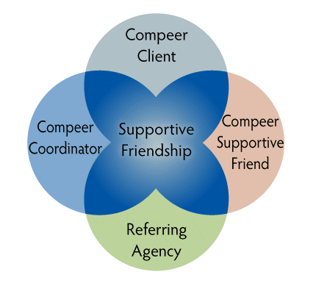
Compeer Model

Slide 31
Contact your local Program to learn how you can make a difference in the life of a veteran.
Compeer Lancaster
630 Janet Ave.
Lancaster, PA. 17601
Phone: 717-397-7461
Compeer Lebanon
710 Maple St., Room 110
Lebanon, PA. 17046
Phone: 717-272-8317
Compeer Pittsburgh
733 South Ave.
Pittsburgh, PA. 15221
Phone: 412-243-3464
Compeer Chester County
825 Paoli Pk. 3FL MB#7
West Chester, PA. 19380
Phone 610-436-4445
Compeer of the Lehigh Valley
411 Walnut Street
Allentown, PA. 18102
Phone: 610-435-9651
Compeer of Butler County
140 N. Elm St. Ste. A
Butler, PA. 16001
Phone: 888-329-0468
Compeer of Sub. Philadelphia
225 S, Chester Rd., Ste. 2B
Swarthmore, PA. 19081
Phone: 610-541-0790
CompeerCORPS programs
Notes:
As of 2016 retreat PCC has ### veteran connections among 6 affiliates

Slide 32
If you don’t see an affiliate in your area please stop by our table in the lobby and ask how we might be able to work together and bring CompeerCORPS to your County

Slide 33

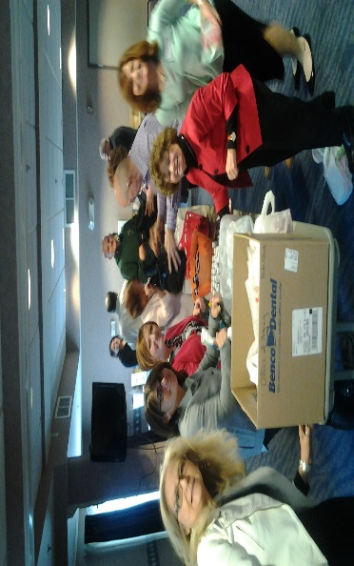
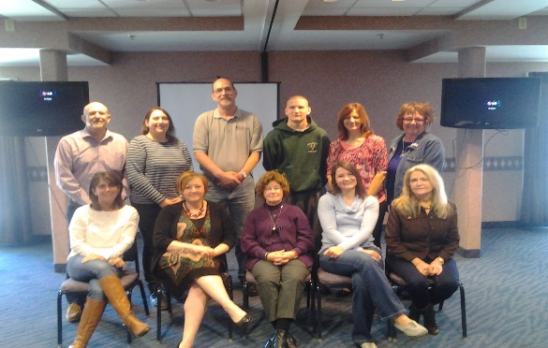
How
Pennsylvania Compeer Coalition is Serving Veterans
Notes:
PCC 2015 Training and retreat affiliates stuffed amenity bags for hospitalized veterans

Slide 34
Many United States military veterans are combating mental and behavioral health problems, homelessness, substance abuse, physical disabilities, lack of community integration and Acceptance. While other veterans have died by suicide.

Slide 35
The purpose of CompeerCORPS Veterans program
is to create a network of military veterans to provide peer mentoring friendships to our referred veterans
The goals of the programs are to enhance a veteran’s self-esteem and self-worth
improve connectedness to civilian society
reduce dependency on emergency services
reduce stigma through friendship
create a strong and supportive environment to successfully lead our veterans to that road to recovery.

Slide 36
MISSION: Using the power of friendship to improve the lives of veterans who are striving for mental health stability.
OUTCOME: Veterans in need receive friendship, camaraderie and Support.
OUTCOME: Trained veteran volunteers enjoy the opportunity to engage in community service and experience self-worth through a supportive friendship.

Slide 38
Goal of the Program are:
To assist with a positive return to civilian life after military service
Broaden interest and hobbies
Create a spirit of service to the community
Bridge generational gap among veteran eras
Encourage overall wellness

Slide 40
Program Description
CompeerCORPS:
is an extension of the traditional Compeer model that serves the veteran population
The purpose of the CompeerCORPS program is to create a supportive network for veteran who benefit from a veteran peer mentor and other community relationships
Veteran volunteers are connected with a veteran based on interest. Age-range, military service and gender

Slide 41
A CompeerCORPS volunteer’s responsibility is to be a friend, role model and an advocate to a veteran who will benefit from a peer mentoring connection with another veteran.

Slide 44
Research has shown that veterans essentially respond better to other veterans

Slide 45
How We Serve:
Collaborate with social services and mental health professionals at the Veterans Administrative Health Care and County providers for referrals of veterans in recovery of mental health challenges to the CompeerCORPS program
Recruit veteran volunteers within service Area
Volunteers must complete an application, provide two character references, go through a screening process, interview, orientation and training
The CompeerCORPS coordinator connects veteran clients and veteran volunteers based on gender, experiences, likes and interests
The coordinator keeps in touch with volunteers and clients - volunteers report monthly activities and submit information regularly about the friendship connection

Slide 46
Who We Serve:
U. S. military veterans from all combat and peacetime eras
Veteran in the care of / or referred by a mental or behavioral health provider or veteran service agency
Veterans working through transition into the civilian community, regardless of years after service
Discharged service members with a DD214 or proof of service
Veterans whose recovery will benefit from an encouraging, supportive friendship

Slide 47
OPPORTUNITY KNOCKS:
As a veteran, you have two options to buddy up:
Become a CompeerCORPS volunteer and befriend a fellow veteran.
Or
Get referred to CompeerCORPS by your Case Manager or Social Worker, and get connected in friendship with a CompeerCORPS veteran volunteer.

Slide 48
Referrals:
Mental Health Professionals, therapist, case managers, social services, behavioral health, are the sources of referrals to the CompeerCORPS program
Referrals and recommendations of individuals must be appropriate for connection with fellow Veteran volunteers
Referring professionals are available for consultation and back-up support to the CompeerCORPS program participants
A yearly evaluation of the program is accomplished by way of a quality survey

Slide 49
The CompeerCORPS Staff:
Agrees to operate the program according to quality assurance standards set by the Compeer International Office in Buffalo, New York and the local sponsor agency
Provides training, friendship matching and monitoring for volunteer and their friend
Provides community and professional education about Compeer, CompeerCORPS and the nature of the mental illness
Recruits Veteran volunteers and Veteran client referrals
Provides continuing support for the CompeerCORPS friendship Connection

Slide 50
The CompeerCORPS Volunteer and Referred Individual:
Participation and interest in CompeerCORPS is voluntary
The volunteer is a supportive friend, not a counselor, therapist, caregiver, banker or taxi service
A monthly report is prepared by the volunteer, listing the meetings and activities shared
The volunteer and friend mutually agree on times to meet or spend time with each other
Both agree to share concerns about their CompeerCORPS friendship with CompeerCORPS staff and/or the referring professional

Slide 51
The glory of friendship is not the outstretched hand, nor the kindly smile, nor the joy of companionship; it is the spiritual inspiration that comes to one when you discover that someone else believes in you and is willing to trust you with a friendship.
~ Ralph Waldo Emerson

Slide 52
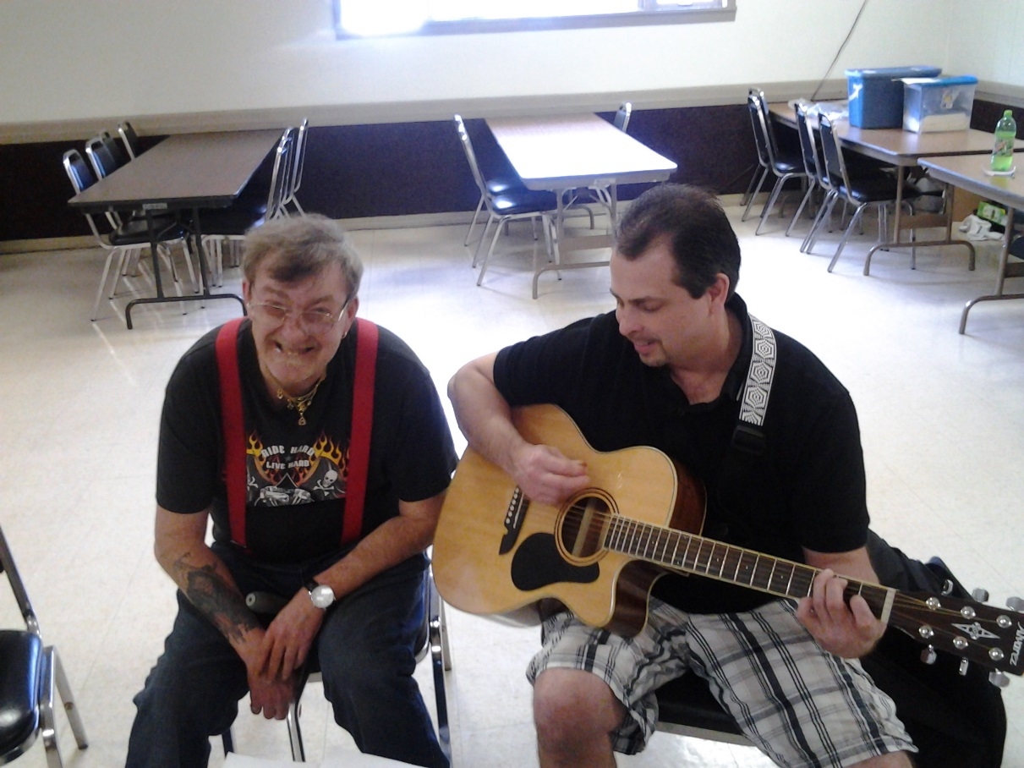
“Their shared experience of being guitar players and Navy veterans has brought them closer.”

Slide 53
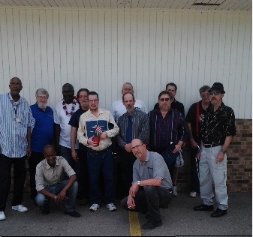
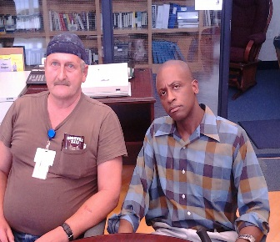
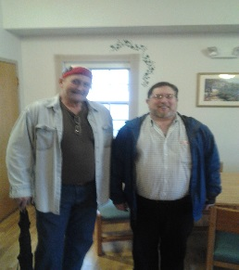
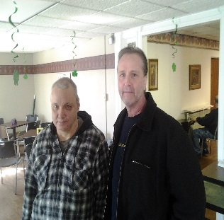
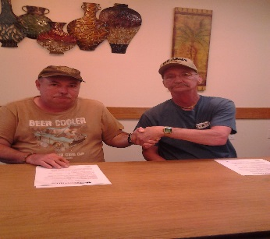
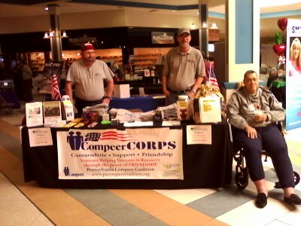
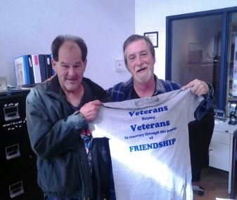
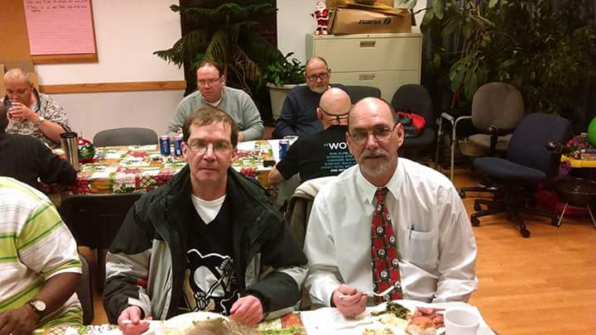
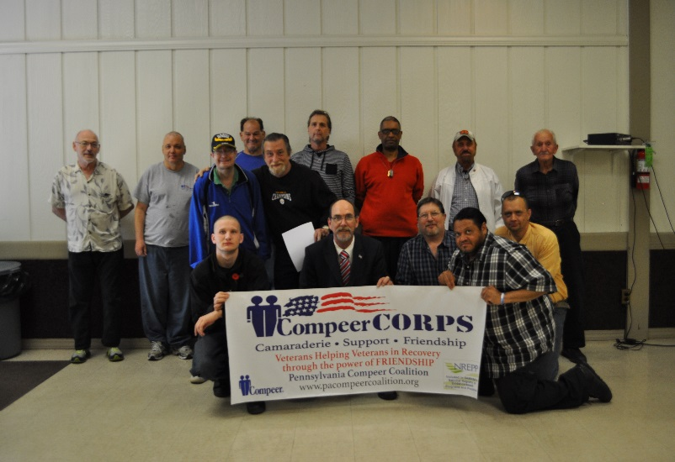
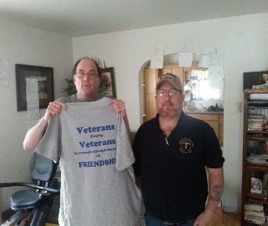
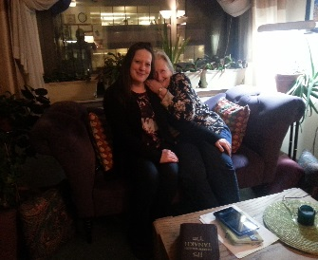
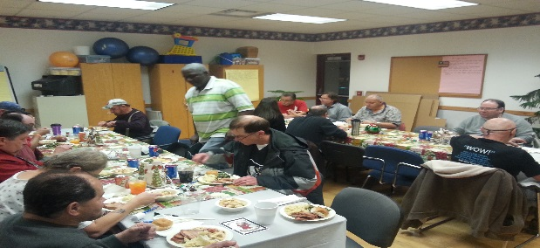
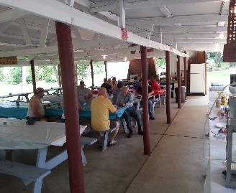
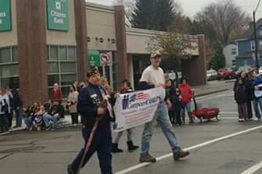
Veterans Helping Veteran in Recovery through the power of FRIENDSHIP

Slide 54


Slide 55
NEXT MEETING
Friday, September 9, 2016 at 10:00AM
Keystone Conference Center
Fort Indiantown Gap
Annville, PA 17003
As of 23 Sep 15
> community > commonwealth
> country

