Slide 1
STATE VETERANS’ COMMISSION MEETING
JUNE 2, 2017

Slide 2
CURRENT AND FUTURE UNIT MOBILIZATIONS
ARNG Unit Soldiers in Theater: 30
ARNG Soldiers at MOB/DEMOB/WTU Site: 7
ARNG Individual Mob: 30
Total ARNG Mob:67
Total PANG Mobilized:211
Current ANG Unit Airmen Mob: 128
Current ANG Individual Mob: 16
Total: ANG Mob: 144
As of 15MAY17
> community > commonwealth
> country

Slide 3
VISN 4 Access Data
 | Oct. 2015 | Nov. 2016 | Feb. 2017 | March 2017
Appointments Within 30 Days | 97.3% | 97.6% | 97.8% | 98.1%
Average Wait Time – Primary Care | 3.4 days | 3.4 days | 3.1 days | 2.5 days
Average Wait Time – Specialty Care | 5 days | 4.8 days | 5.2 days | 4.18 days
Average Wait Time – Mental Health Care | 2.3 days | 3 days | 3 days | 2.5 days
Outpatient Appointments | 205,006 | 186,344 | 182,269 | 212,365
June 2017 Update
> community > commonwealth
> country
Notes:
Anne M

Slide 4
VISN 4 Trust Data - Inpatients
 | November Update | January Update | March Update | June Update
Time Range of Data | FY16 through July 2016 | All of FY16 | FY17 through Dec. 2016 | FY17 through Jan. 2017
“I got the service I needed” (Effectiveness) | 88.5 | 88.2 | 84.5 | 85.4
“It was easy to get the service I needed” (Ease) | 84 | 83.4 | 81.3 | 82.4
“I felt like a valued customer” (Emotion) | 84 | 84.3 | 79.3 | 80.5
“I trust VA to fulfill our country’s commitment to Veterans” (Trust) | 83 | 83.6 | 80.2 | 81.3
% of responses with agree or strongly agree
June 2017 Update
> community > commonwealth
> country
Notes:
Moira H & Gwen H

Slide 5
VISN 4 Trust Data - Outpatients
 | November Update | January Update | March Update | June Update
Time Range of Data | FY16 through July 2016 | All of FY16 | FY17 through Dec. 2016 | FY17 through Jan. 2017
“I got the service I needed” (Effectiveness) | 86.3 | 86 | 85.8 | 85.9
“It was easy to get the service I needed” (Ease) | 79.6 | 79.1 | 79.3 | 79.9
“I felt like a valued customer” (Emotion) | 80.8 | 80.5 | 81.1 | 81.8
“I trust VA to fulfill our country’s commitment to Veterans” (Trust) | 75.6 | 75.4 | 76.3 | 76.9
% of responses with agree or strongly agree
June 2017 Update
> community > commonwealth
> country
Notes:
Moira H & Gwen H

Slide 6
VISN 4 Community Care Data
 | Oct. 2016 Update | Feb. 2017 Update | April 2017 Update
Current Number of Provider Agreements | 789 | 1,223 | 1,376
Care in the Community Appointments Completed
Fiscal Year 2016 | 77,709
Fiscal Year 2017 through… | November 2016 | January 2017 | March 2017
 | 12,083 | 19,171 | 29,834
June 2017 Update
> community > commonwealth
> country
Notes:
Barb W

Slide 7
VA’s 5 Priorities
Greater Choice for Veterans
Modernize our System
Focus Resources More Effectively
Improve Timeliness of Services
Suicide Prevention
Getting to Zero
Access to Care and Wait Times
Decisions on Appeals
Performance on Disability Claims
Strengthening of Foundational Services in VA
VA/DoD/Community Coordination
Deliver on Accountability and Effective Management Practices
Infrastructure Improvements and Streamlining
EMR Interoperability and IT Modernization
Redesign the 40/30 Rule
Build a High Performing Integrated Network of Care
Empower Veterans Through Transparency of Information
June 2017 Update
> community > commonwealth
> country
Notes:
Moira H & Gwen H

Slide 8
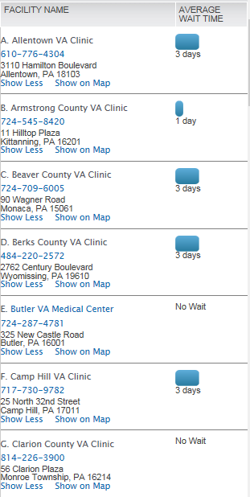
Access and Quality in VA Healthcare Tool
Primary care
return appointment
wait time
www.accesstocare.va.gov
June 2017 Update
> community > commonwealth
> country
Notes:
Moira H & Gwen H

Slide 9
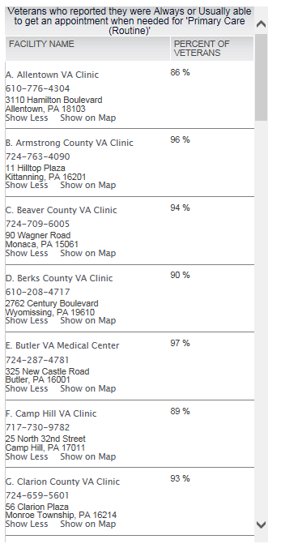
Access and Quality in VA Healthcare Tool
Veteran satisfaction with access to routine
primary care appointment
www.accesstocare.va.gov
June 2017 Update
> community > commonwealth
> country
Notes:
Moira H & Gwen H

Slide 10
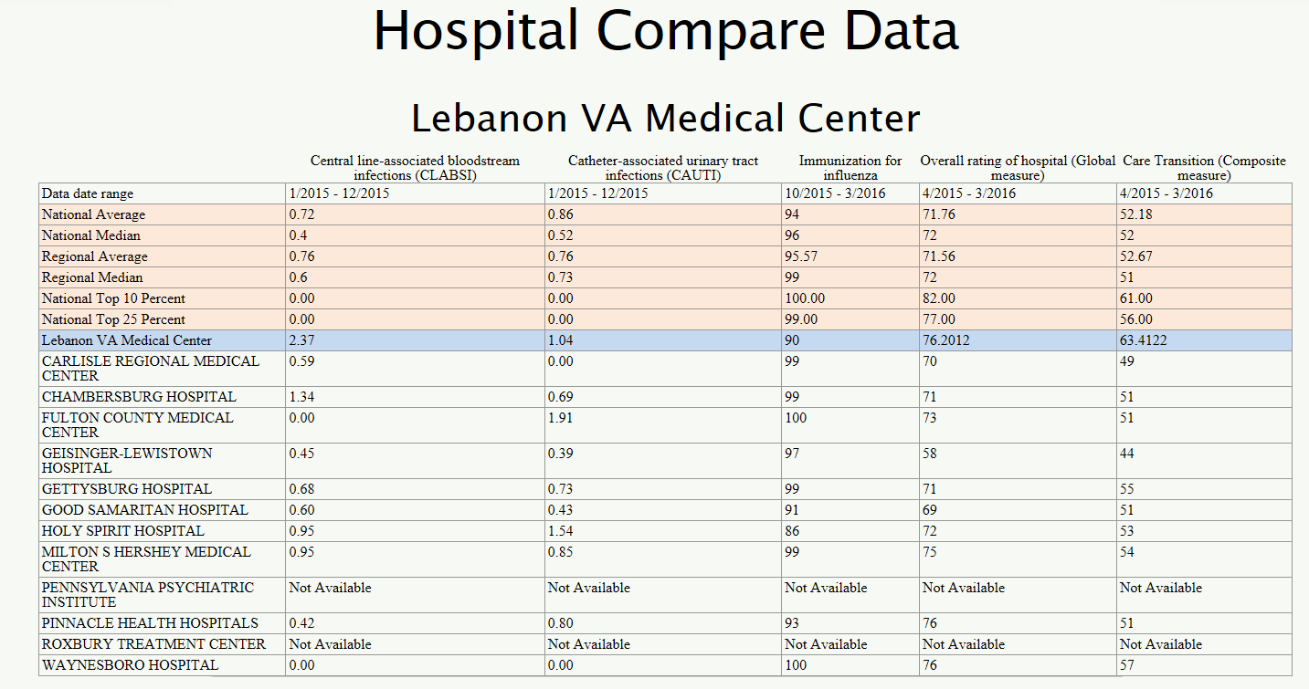
Access and Quality in VA Healthcare Tool
www.accesstocare.va.gov
June 2017 Update
> community > commonwealth
> country
Notes:
Moira H & Gwen H

Slide 11
Current Licensure Status
BUREAU OF VETERANS’ HOMES
Regulatory Agency | DVVH | GMVC | HVH | PSSH | SEVC | SWVC
Date of Last Inspection - Status
PA Department of Health | 01/20/2017 Full Standard Licensure Status | 12/08/2016 Full Standard Licensure Status | 02/17/2017 Full Standard Licensure Status | 12/02/2016 Full Standard Licensure Status | 11/18/2016 Full Standard Licensure Status | 12/09/2016 Full Standard Licensure Status
PA Department of Human Services | 03/2017 Full Standard Licensure Status | License Vacated on 11/27/2012 | 11/2016 Full Standard Licensure Status | 08/2016 Full Standard Licensure Status | 03/2017 Full Standard Licensure Status | License Vacated on 01/16/2015
US Department of Veterans Affairs | 04/2016 Full Standard Licensure Status | 03/2017 Full Standard Licensure Status | 01/2017 Full Standard Licensure Status | 03/2017 Full Standard Licensure Status | 02/2017 Full Standard Licensure Status | 01/2016 Full Standard Licensure Status
As of 30 APR 17
> community > commonwealth
> country

Slide 12
BUREAU OF VETERANS’ HOMES
Upcoming Events for the Veterans’ Homes
2017 Veterans Annual Fishing Event
Tuesday June 6, 2017, Dauphin County Anglers & Conservation on Clarks Creek. Fishing starts at 1000 hours.
2017 State Veterans’ Homes Week
June 11 through 18, 2017, week long activates and events will be taking place at each veterans‘ home.
As of 30 APR 17
> community > commonwealth
> country

Slide 13
OPERATIONAL HIGHLIGHTS
Budget/Re-Budget
-We continue to assess the impacts of budget cuts
-Educational Gratuity Program has demonstrated unmet need for the past
two years. We will be requesting a budget increase in this line item for SFY 18-19 (+50K)
Governors Advisory Council for Veterans Services
-Meeting was held on 17 May
-Subcommittees provided reports
-No outstanding issues or concerns
Veterans Symposium
-We missed the boat last year
-Does the SVC wish to plan a Veterans Symposium for SFY 17-18?
PIRO Update
> community > commonwealth
> country

Slide 14
PERSIAN GULF BONUS PROGRAM SUMMARY
VETERANS TEMPORARY ASSISTANCE
$800,000
Lapse $0
Projected Expenditures
$ 129,358
Expended $ 670,642
479 Claimants
on the program
585 Claimants
436 Claimants
As of 18 May 2017
> People > Processes
> Technology
> community > commonwealth
> country

Slide 15
PERSIAN GULF BONUS PROGRAM SUMMARY
BLIND VETERANS PENSION
$222,000
Lapse $0
Projected Expenditure
$ 39,750
Expended $ 182,250
FY 14-15
FY 15-16
FY 16-17
115 Claimants
116 Claimants
108 Claimants
> People > Processes
> Technology
As of 18 May 2017
> community > commonwealth
> country

Slide 16
AMPUTEE & PARALYZED VETERANS PENSION
As of 18 May 2017
> community > commonwealth
> country

Slide 17
PERSIAN GULF BONUS PROGRAM SUMMARY
EDUCATIONAL GRATUITY
$120,000
Lapse $0
Projected Expenditure $ 870.50
Expended $ 119,129.50
137 Claimants on program
As of 15 Jan 14
186 Claimants
134 Claimants
100 Claimants Projected
As of 18 May 2017
> People > Processes
> Technology
> community > commonwealth
> country

Slide 18
PERSIAN GULF BONUS PROGRAM SUMMARY
DISABLED VETERANS TAX EXEMPTION PROGRAM
As of 15 Jan 14
As of 18 May 2017
> People > Processes
> Technology
> community > commonwealth
> country

Slide 19
PERSIAN GULF BONUS PROGRAM SUMMARY
DISABLED VETERANS’ RETX PROGRAM
As of 15 Jan 14
*560 Applications Received since 25 March 2017
As of 18 May 2017
MAY 14
> People > Processes
> Technology
> community > commonwealth
> country

Slide 20
PERSIAN GULF BONUS PROGRAM SUMMARY
PERSIAN GULF VETERANS BENEFIT PROGRAM
Total Applications: 12,099
Payments Sent: 9,385
Total Payments: $3,979,137.50
Average Payment: $423.99
Average Processing Time: 5.83 days
As of 18 May 2017
> People > Processes
> Technology
> community > commonwealth
> country

Slide 21
PERSIAN GULF BONUS PROGRAM SUMMARY
MILITARY FAMILY RELIEF ASSISTANCE PROGRAM
OVERALL MFRAP CONTRIBUTIONS - FY 2005 THRU 18 MAY 2017
TOTAL PRIVATE CONTRIBUTIONS | $ 124,179.77
DEPT OF REVENUE - PIT DONATIONS | $ 1,656,919.09
TOTAL ALL CONTRIBUTIONS - PRIVATE & PIT DONATIONS | $ 1,781,098.86
APPROVED GRANT APPLICATION PAYMENTS | $ 808,084.86
ACCOUNT BALANCE | $ 973,014.00
As of 15 Jan 14
> People > Processes
> Technology
As of 18 May 17
> community > commonwealth
> country

Slide 22
PENNSYLVANIA VETERANS MEMORIAL
Pennsylvania Veterans Memorial Trust Fund
Beginning Trust Fund Balance (July 1, 2016) | $565,829.99
Grants Received | 0
Public / Private Donations | $4,955.02
Interest | $3,333.92
Refunds of Expenditures | $28.70
Total Receipts | $8,317.64
Expenses | ($128,106.14)
Ending Balance | $446,041.49
As of 18 May 2017
> community > commonwealth
> country

Slide 23
ODAGVA / ACT 66 SUMMARY
FY 16 - 17 Claims, Compensation and Pension Summary
Year to Date Claims Submitted | Year to Date Value of Awards
*25,184 | *$78,060,549.00
* ODAGVA and Act 66 combined data will be available when DMVA completes the Vetraspec data conversion.
FY 15 - 16 Claims, Compensation and Pension Summary
Year to Date Claims Submitted | Year to Date Value of Awards
22,733 | $254,503,769.00
As of 19 May 17
> community > commonwealth
> country
S:\VA_Share\Chief, Division of Reintegration and Outreach\SVC Slide Presentations\SVC Slides SFY 16-17

Slide 24
OUTREACH ENGAGEMENTS
Outreach Statistics
 | 1st Qtr | 2nd Qtr | 3rd Qtr | 4th Qtr | Year to Date
Outreach Events Supported | 51 | 42 | 17 | 14 | 124
Mobile Outreach Van Events | 43 | 36 | 11 | 9 | 99
Veteran Interactions | 1,011 | 541 | 661 | 212 | 2,425
Claim referrals to County Directors and Service Organizations | 157 | 118 | 128 | 35 | 438
Legislator Attended Events | 17 | 17 | 3 | 12 | 49
Notes Two outreach vans are operational and supporting outreach events Upcoming Events – May Legislative Events – Rep. Metcalf’s Senior Expo – Sen. White/Rep. Nelson Senior Fair – Rep. Krueger- Braneky Veterans Outreach – Sen. Stefano’s Senior Expo - Events – Wellsboro Veteran’s Fair and Expo – Philadelphia Veterans Advisory Commission – Carlisle Expo and Job Fair – Drexel Hill Veterans Appreciation Breakfast – Iheart Wings over Pittsburgh Open House – Salute to the Military, Chambersburg – DMVA Annual Health and Wellness Fair – Hermitage Armed Forces Day – Downingtown Armed Forces Appreciation Day – Cabela’s Veteran Outreach Legislators Attending Events – Senators McIlhinney, Laughlin, Alloway and Rescenthaler. Representatives McNeill, Bizzarro, Gillen, Klunk and Saccone.
As of 19 May 17
> community > commonwealth
> country
S:\VA_Share\Chief, Division of Reintegration and Outreach\SVC Slide Presentations\SVC Slides SFY 16-17

Slide 25
VETERANS’ TRUST FUND
Revenue | Since Last Meeting | SFY 16-17 | Cumulative Total
Checkoff & Donations | $246,859.00 | $1,497,442.00 | $5,647,165.00
HOV License Plate | $540.00* | $2,910.00 | $39,345.00
PA Monuments License Plate | $253.00* | $1,587.00 | $15,755.00
Interest | $1,859.00 | $13,721.00 | $26,292.00
Disbursements
VTF Grants | $0.00** | $529,757.00 | $2,000,048.00
VTA | $74,217.00 | $587,457.00 | $1,932,809.00
PENN DOT Costs | $194,000.00*** | $194,000.00 | $966,000.00
Total number of HOV License plates sold since last meeting = 36 (Total since inception = 2,623)
*Total number of PA Monuments License plates sold since last meeting = 11 (Total since inception = 675)
**Awards and distribution of funds are contingent upon the completion of a fully executed grant agreements
*** PENNDOT PAYMENT/INVOICING – DMVA has Agreed to pay $194,000/FY over four years. Final payment of $194,000 was made to PENNDOT (Total Cost was 966,000.00)
As of 19 May 17
> community > commonwealth
> country
S:\VA_Share\Chief, Division of Reintegration and Outreach\SVC Slide Presentations\SVC Slides SFY 16-17

Slide 26
BUREAU OF VETERANS’ HOMES
Admissions Critical Criteria
First Come First Served
Honorable or General Discharge
Primary & Secondary Lists, Veterans & Non Veterans
Pennsylvania Resident
Joined Military while living in Pennsylvania
5 days to accept a bed and establish a Move-In Day
Can request additional 5 days = 10 days
Extenuating Circumstances
2 JUN 17
> community > commonwealth
> country

Slide 27
BUREAU OF VETERANS’ HOMES
Admissions Critical Criteria
Continued
12% Non Veteran Population at Each Home
Spouses
Reserve/NG without Active Duty
Transfer between homes
No outstanding Balance
1 Transfer
Reference PA Code 43, Chapter 7
2 JUN 17
> community > commonwealth
> country

Slide 28
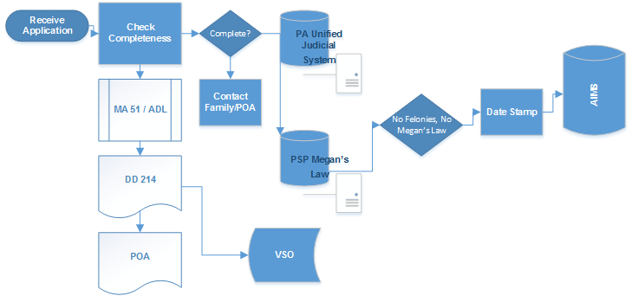
BUREAU OF VETERANS’ HOMES
Bureau of Veterans Homes Application Process
2 JUN 17
> community > commonwealth
> country

Slide 29
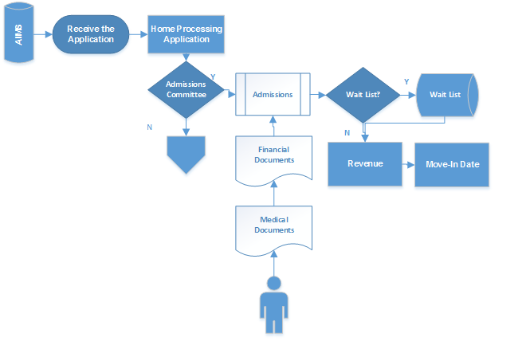
BUREAU OF VETERANS’ HOMES
State Veterans’ Home Application Process
2 JUN 17
> community > commonwealth
> country

Slide 30
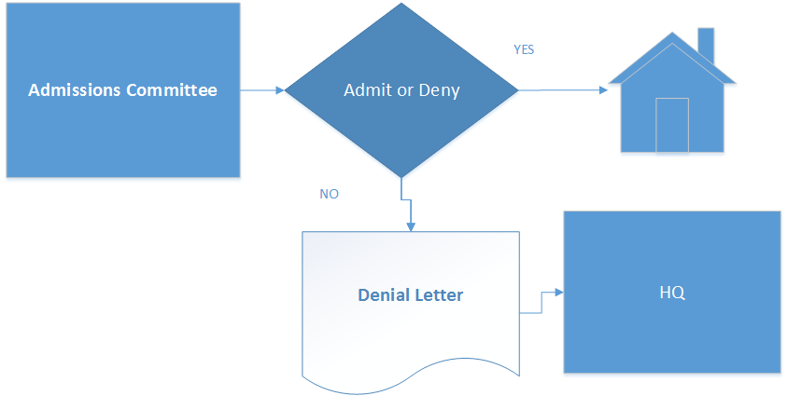
BUREAU OF VETERANS’ HOMES
Denial Process
2 JUN 17
> community > commonwealth
> country

Slide 31
BUREAU OF VETERANS’ HOMES
Current Wait Lists
 | % Fill |  | Wait List Vet | Wait List Non-Vet
DVVH
Nursing | 100% |  | 24 | 43
Dementia | 100% |  | 1 | 10
Personal | 93% |  | 12 | 15
Non Vet % 7
GMVC
Nursing | 93% |  | 2 | 37
Dementia | 95% |  | 0 | 0
Non Vet % 13
HVH
Nursing | 72% |  | 0 | 25
Dementia | 48% |  | 0 | 0
Personal | 67% |  | 0 | 1
Domiciliary | 83% |  | 0 | 0
Non Vet % 11
PSSH
Nursing | 99% |  | 0 | 3
Dementia | 100% |  | 15 | 5
Personal | 83% |  | 1 | 1
Domiciliary | 100% |  | 0 | 0
Non Vet % 10
SEVC
Nursing | 97% |  | 22 | 16
Dementia | 90% |  | 0 | 0
Personal | 74% |  | 8 | 0
Non Vet % 13
SWVC
Nursing | 92% |  | 13 | 2
Dementia | 93% |  | 3 | 0
Non Vet % 11
2 Jun 17
> community > commonwealth
> country

Slide 32
BUREAU OF VETERANS’ HOMES
Information is Knowledge
Help Spread the Word about the State Veterans’ Homes
Distribute Homes Brochures
Direct Applicants to www.dmva.pa.gov/stateveteranshomes
Applications
Information
Pictures
Veterans Registry
Thank you
Your support to the Homes
Your support to Pennsylvania Veterans
2 JUN 17
> community > commonwealth
> country

Slide 33
NEXT MEETING
Friday, September 8, 2017
at 10:00AM
Keystone Conference Center
Fort Indiantown Gap
Annville, PA 17003
Approved at the October 14, 2016 State Veterans’ Commission Meeting
> community > commonwealth
> country

