Slide 1
CURRENT AND FUTURE UNIT MOBILIZATIONS
ARNG Unit Soldiers in Theater: 152
ARNG Soldiers at MOB/DEMOB Site: 367
ARNG Individual Mob: 19
Total ARNG Mob: 538
Total PANG Mobilized: 716
Current ANG Unit Airmen Mob: 178
Total: ANG Mob: 178
As of 06SEPT16
> community > commonwealth
> country
Notes:
CHANGES SINCE LAST UPDATE:
ARNG:
28th ID 1-110th currently awaiting 3 pax fills :2 MOB on 03JUN16; 1 MOB on 10JUN16

Slide 2
CURRENT MOBILIZATIONS & TOTAL DEPLOYMENTS
PAARNG Current Deployments
MDATE | MSAD | UNIT | OPN | PAX | MISSION | Projected Return Date
30 SEP 15 | 03 OCT 15 | DET 1 2/104th | OEF-KU | 24 | MEDEVAC | 02 NOV 16
07 JAN 16 | 09 JAN 16 | 2IBCT | KFOR | 96 | SECURITY | 07 JAN 17
29 JAN 16 | 01 FEB 16 | 2 IBCT NATO 33 | KFOR-OJG | 29 | POSTAL | 27JAN 17/18 FEB 17
11 MAY 16 | 14 MAY 16 | 28ID 1-110th | OEF UAE/OIR | 370 | SECFOR/TNG | o/a 14JUN17
Various Individual MOB Soldiers |  |  |  | 19 | Various Missions | TBD
Total PAARNG Deployed: 538
Total PANG Deployed 725
As of 26AUG16
> community > commonwealth
> country

Slide 3
BUREAU OF VETERANS’ HOMES
Veterans’ Homes Update
Performance Audit Report
Pennsylvania Department of Health (DOH)
The Department Of The Auditor General conducted an audit of the DOH oversight of nursing homes in Pennsylvania.
In the report, there were 13 findings and 23 recommendations addressing three main areas of concern: inadequate review of nurse staffing levels; DOH handling of complaints; and sanctions imposed on poor-performing facilities.
Based on this audit the response from DOH included announcement of increasing enforcement of regulatory sanctions. Examples included issuance of more Provisional licenses, and civil monetary penalties above past 2015 numbers.
As of 31 AUG 16
> community > commonwealth
> country

Slide 4
BUREAU OF VETERANS’ HOMES
Licensure Updates
Southwestern Veterans’ Center – Pittsburgh PA
Based on the Department of Health (DOH) inspection on July 14, 2016 SWVC obtained three deficiencies on the most recent abbreviated survey / inspection. Based off of this survey SWVC was issued a Provisional I license for the facility. The home has executed their plan of correction for all identified deficiencies from DOH and has a date certain for compliance of September 12, 2016.
SWVC has begun the appeal process for this DOH licensure decision.
SWVC will remain on Provisional I Licensure with an overall compliance date of January 14, 2017. Currently the facility is awaiting an unannounced inspection from DOH to verify their plan of correction from previously cited deficiencies.
As of 31 AUG 16
> community > commonwealth
> country

Slide 5
BUREAU OF VETERANS’ HOMES
As of 31 AUG 16
> community > commonwealth
> country

Slide 6
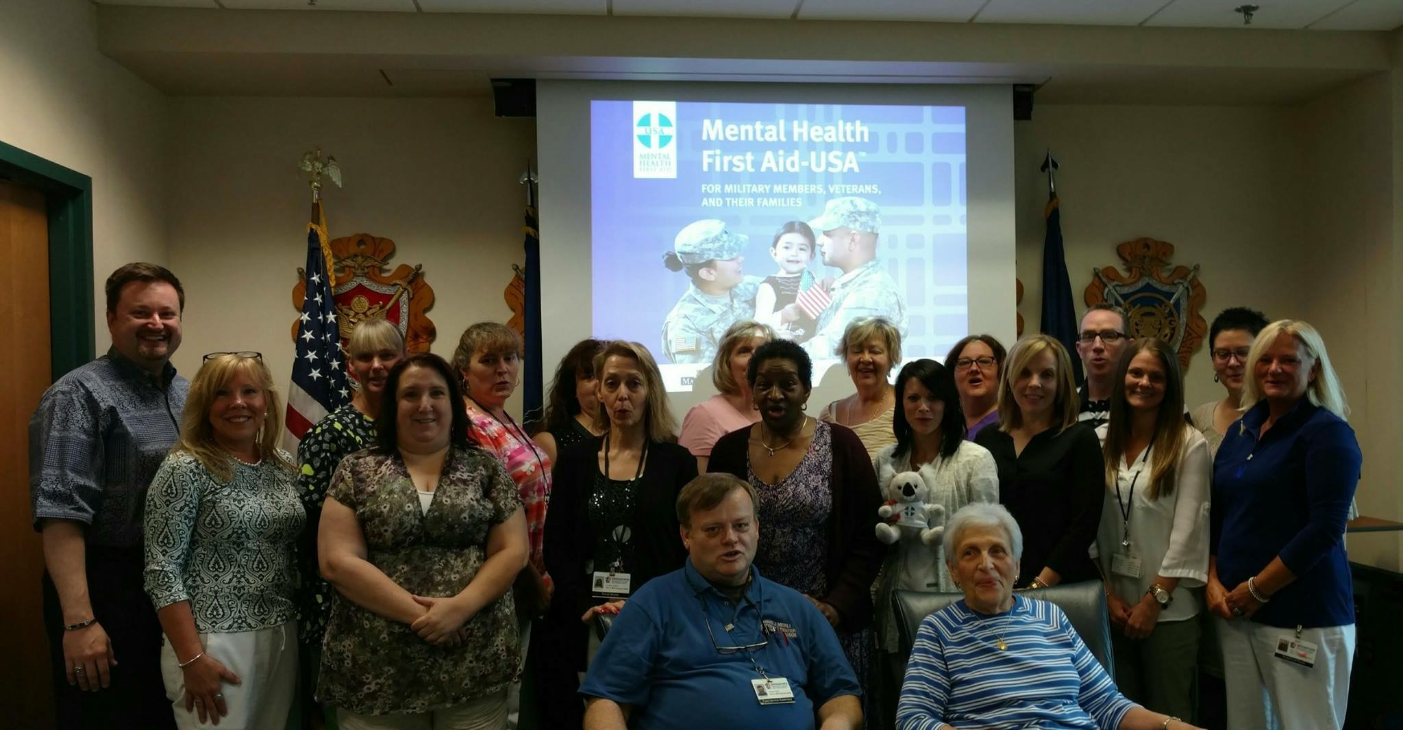
BUREAU OF VETERANS’ HOMES
As of 31 AUG 16
> community > commonwealth
> country

Slide 7
BUREAU OF VETERANS’ HOMES
As of 31 AUG 16
> community > commonwealth
> country

Slide 8
BUREAU OF VETERANS’ HOMES
As of 31 AUG 16
> community > commonwealth
> country

Slide 9
BUREAU OF VETERANS’ HOMES
As of 31 AUG 16
> community > commonwealth
> country

Slide 10
BUREAU OF VETERANS’ HOMES
Pennsylvania Blood Tests Submitted
for Zika Testing Information updated Mondays at 2 p.m.
Confirmed Infections: 95
Pending Test Results: 45
Last update: 08/29/2016
www.zika.pa.gov
As of 31 AUG 16
> community > commonwealth
> country

Slide 11
BUREAU OF VETERANS’ HOMES
As of 31 AUG 16
> community > commonwealth
> country

Slide 12
Operational Highlights
SFY 16-17 Budget Update
Flat Budget that sustains operations at the same level as previous years
OPTEMPO.
-New positions to “Right Size” the Office of Veterans Affairs are approved
-Veteran Service Specialist x2
-Clerk II
-AO1 to support GAC-VS
-AO1 to support D2D
Notice of Funding Announcement (NOFA)
-VTF Grants Budget SFY 16-17
As of 25 Mar14
PIRO Update
> community > commonwealth
> country

Slide 13
OVA Operational Action Plans
Strategic Plan Working Group
SVC/DMVA-OVA. Single year appointment with ability to extend appointment
over multiple years with approval of SVC.
Initiatives, Focus, Resourcing, Advocacy, Legislative Priorities
Veteran’s Trust Fund
Committee – SVC/DMVA-OVA. Single year appointment with ability to
extend appointment over multiple years with approval of SVC.
Notice of Funding Announcement (NOFA)
VTF Grants Budget
VTF Grants Review Committee
VTA Budget
Annual Veterans Symposium
Veteran Award Program
Committee/Working Group – SVC/DMVA-OVA. Single year appointment with
ability to extend appointment over multiple years with approval of SVC
Establish Policy, define criteria and processes to manage Veteran Awards
Meet as needed but at least once Quarterly
Establish an Awards Board to review, approve and process Veteran Awards
As of 25 Mar14
PIRO Update
> community > commonwealth
> country

Slide 14
OVA Operational Action Plans
RETX Program Working Group
Re-Set the RETX Working Group to complete necessary action/make appropriate
recommendations to DAG-VA .
Priority for Legislative Changes.
Veteran Service Officer Grant Program (Act 66 of 2007)
Program Guidelines – Joint Committee/Working Group to review annually
and adjust to meet emerging needs of our Veterans.
Budget Considerations – Budget Ask for $500K Annually over a 5 year period
to meet Strategic Plan Goals and milestones.
Operational Outreach Plan(s)
SVC/Veteran Service Organizations/DMVA-OVA Outreach.
Initiatives, Focus, Resourcing, Advocacy, Goals, Cooperation
-Veterans Symposium
-Veterans Day at the Capitol (October 19 0700-1330)
-TAG Fishing Tournament
-Vietnam Veterans Day at the Capitol – March 29 (Annually)
As of 25 Mar14
PIRO Update
> community > commonwealth
> country

Slide 15
OVA Operational Action Plans
DMVA/VSO Partner Information Video Initiative
Highlight the role of DMVA and the Veteran Service Organization partners
as we work together to meet the emerging needs of our Veterans
-VSO Round Table
-OVA Advertising Budget (200K)
Governors Advisory Council for Veterans Services
Committee appointments on an annual basis
Standing Committees were formed and will report to the GAC-VS
on a quarterly basis.
GAC-VS Budget – Advocate for modest operating budget of 25K
Digits to Digits (D2D) Initiatives
-Veterans Registry
-Claims Management Software Initiative
-Training and Accreditation
-State Benefits/Program Integration
As of 25 Mar14
PIRO Update
> community > commonwealth
> country

Slide 16
PERSIAN GULF BONUS PROGRAM SUMMARY
VETERANS TEMPORARY ASSISTANCE
$600,000
Lapse $0
Projected Expenditures
$ 499,676
Expended $ 100,324
76 Claimants
on the program
585 Claimants
436 Claimants
As of 19 Aug 2016
> People > Processes
> Technology
> community > commonwealth
> country

Slide 17
PERSIAN GULF BONUS PROGRAM SUMMARY
BLIND VETERANS PENSION
$222,000
Lapse $0
Projected Expenditure
$190,650
Expended $ 31,350
FY 13-14
FY 14-15
FY 15-16
118 Claimants
115 Claimants
104 Claimants
> People > Processes
> Technology
As of 19 AUG 2016
> community > commonwealth
> country

Slide 18
AMPUTEE & PARALYZED VETERANS PENSION
As of 19 AUG 2016
> community > commonwealth
> country

Slide 19
PERSIAN GULF BONUS PROGRAM SUMMARY
EDUCATIONAL GRATUITY
$101,000
Lapse $0
Projected Expenditure $101,000
Expended $ 0
0 Claimants on the program
As of 15 Jan 14
186 Claimants
134 Claimants
100 Claimants Projected
As of 19 AUG 2016
> People > Processes
> Technology
> community > commonwealth
> country

Slide 20
PERSIAN GULF BONUS PROGRAM SUMMARY
DISABLED VETERANS TAX EXEMPTION PROGRAM
As of 15 Jan 14
As of 19 AUG 2016
> People > Processes
> Technology
> community > commonwealth
> country

Slide 21
PERSIAN GULF BONUS PROGRAM SUMMARY
DISABLED VETERANS’ RETX PROGRAM
As of 15 Jan 14
*760 Applications Received since MAY 19, 2016
As of 19 AUG 2016
MAY 14
> People > Processes
> Technology
> community > commonwealth
> country

Slide 22
PERSIAN GULF BONUS PROGRAM SUMMARY
PERSIAN GULF VETERANS BENEFIT PROGRAM
Total Applications: 12,016
Payments Sent: 9,290
Total Payments: $3,941,112.50
Average Payment: $424.15
Average Processing Time: 5.42 days
As of 19 AUG 2016
> People > Processes
> Technology
> community > commonwealth
> country

Slide 23
PERSIAN GULF BONUS PROGRAM SUMMARY
MILITARY FAMILY RELIEF ASSISTANCE PROGRAM
OVERALL MFRAP CONTRIBUTIONS - FY 2005 THRU 19 AUG 2016OVERALL MFRAP
TOTAL PRIVATE CONTRIBUTIONS | $ 117,995.76
DEPT OF REVENUE - PIT DONATIONS | $ 1,577,455.37
TOTAL ALL CONTRIBUTIONS - PRIVATE & PIT DONATIONS | $ 1,695,451.13
APPROVED GRANT APPLICATION PAYMENTS | $ 773,781.86
ACCOUNT BALANCE | $ 921,669.27
As of 15 Jan 14
> People > Processes
> Technology
As of 19 AUG 2016
> community > commonwealth
> country

Slide 24
PENNSYLVANIA VETERANS MEMORIAL
Estimated Repairs | Estimated Cost
Priority 1 Wall Cap Repairs | $17,000
Priority 2 Main Entrance Repairs | $70,000
Priority 3 Amphitheater Repairs | $771,000
Priority 4 Crack Restoration | $1,700,000
Total | $2,558,000
Repairs Not Included In The Estimate
Tree Replacement (36)
Repairs To The Colored Concrete
Electrical Work
Daily Operations
Unexpected Repairs
As of 19 AUG 2016
> community > commonwealth
> country

Slide 25
PENNSYLVANIA VETERANS MEMORIAL
Pennsylvania Veterans Memorial Trust Fund
Beginning Trust Fund Balance (July 1, 2016) | $565,829.99
Grants Received | 0
Public / Private Donations | $17,770
Interest | $272.72
Refunds of Expenditures | $13.57
Total Receipts | $2,056.29
Expenses | ($6,599.76)
Ending Balance | $561,286.52
As of 25 AUG 2016
> community > commonwealth
> country

Slide 26
PENNSYLVANIA VETERANS MEMORIAL
Repairs Completed
Low Wall caps
High Jagged Wall Cap
Work will begin on the entrance way, repairs are for the settled ground
Calcium Cleaning Proposal Tested
The solution tested was not acceptable
As of 19 AUG 2016
> community > commonwealth
> country

Slide 27
ODAGVA / ACT 66 SUMMARY
FY 16 - 17 Claims, Compensation and Pension Summary
Year to Date Claims Submitted | Year to Date Value of Awards
3,548 | $9,448,608.00
FY 15 - 16 Claims, Compensation and Pension Summary
Year to Date Claims Submitted | Year to Date Value of Awards
22,733 | $254,503,769.00
As of 26 August 16
> community > commonwealth
> country

Slide 28
OUTREACH ENGAGEMENTS
Outreach Statistics
 | 1st Qtr | 2nd Qtr | 3rd Qtr | 4th Qtr | Year to Date
Outreach Events Supported | 28 |  |  |  | 28
Mobile Outreach Van Events | 24 |  |  |  | 24
Veteran Interactions | 656 |  |  |  | 656
Claim referrals to County Directors and Service Organizations | 105 |  |  |  | 105
Legislator Attended Events | 10 |  |  |  | 10
Notes Two outreach vans are operational and supporting outreach events Upcoming Events – September Legislative Events – Rep. Christina’s Veteran Breakfast – Rep. Deasey’s Senior Health Fair – Sen. Stefano and Rep. Warner’s Senior Expo – Rep. Costa Senior health Fair – Sen. Brewster Senior Expo Events – Carbon County Senior Expo – Wayne/Pike Suicide Walk – Ross Township Community Day – Pennsylvania Bow hunters Festival – Tannersville Wellness Fall Festival – 95th District Health and Wellness Fair – Northumberland Behavior Health Event – Mifflintown Fall Festival Legislators Attending Events – Congressmen Marino and Rothfus, Senators White and Brown, Representatives Nelson, Acosta, Miller, Keller, Metzger, Baker, Ellis and Saccone
As of 26 August 16
> community > commonwealth
> country

Slide 29
VETERANS’ TRUST FUND
Revenue | Since Last Meeting | SFY 16-17 | Cumulative Total
Checkoff & Donations | $240,393.00 | $240,393.00 | $4,390,115.00
HOV License Plate | $960.00* | $2,745.00 | $37,395.00
PA Monuments License Plate | $782.00* | $3,473.00 | $14,950.00
Interest | $2,255.00 | $5,486.00 | $14,826.00
Disbursements
VTF Grants | $529,757.00** | $0.00 | $932,860.00
VTA | $100,324.00 | $100,324.00 | $1,360,891.00
PENN DOT Costs | $194,000.00*** | $0.00 | $772,000.00
Total number of HOV License plates sold since last meeting = 64 (Total since inception = 2,493)
*Total number of PA Monuments License plates sold since last meeting = 34 (Total since inception =650)
**Awards and distribution of funds are contingent upon the completion of a fully executed grant agreements
*** PENNDOT PAYMENT/INVOICING – DMVA has Agreed to pay $194,000/FY over four years. Current Balance is $194,000. DOT will issue invoices at the beginning of April for Annual Payments. (Total Cost was 966,000.00)
As of 26 Aug 2016
> community > commonwealth
> country

Slide 30
DISABLED VETERANS TAX EXEMPTION PROGRAM COMMITTEE
REPORT OF THE PENNSYLVANIA STATE VETERANS COMMISSION COMMITTEE ON PROPERTY TAX EXEMPTION
UPDATE # 2
LTC NICHOLAS M. TAYLOR, US ARMY (Ret.), Chairman
9 SEPTEMBER 2016

Slide 31
DISABLED VETERANS TAX EXEMPTION PROGRAM COMMITTEE
DAG-VA 3 Courses of Action:
COA # 1: Provisions to benefit Veterans of retirement age (over 62)
COA # 2: Create a proportional system to award tax exemption
COA # 3: Maintain the program as it is currently written
Committee Agreed Upon Facts:
Dismiss COA # 3…The program needs to be changed
Determination of Need shall remain with the State Veterans Commission and not ceded to the legislature (current statute)
Recommendations forthcoming to the State Legislature for Constitutional or Statute changes
One Size DOES NOT Fit All
Best solution is a combination prorated or proportional approach
Examination of other states’ methodologies
Add an eligibility provision for spouses of those Killed in Action that meet all the other eligibility criteria
Concur with and move forward with answers (unanimous or majority) from the “12 Questions” posed to the Veterans’ organizations
To the extent permitted under current law, direct DMVA Veterans Services to implement the desires of the Commission
Using geographical median household / family income figures, determine a fair and equitable limit by county

Slide 32
DISABLED VETERANS TAX EXEMPTION PROGRAM COMMITTEE
Recommended Committee Actions Not Requiring Policy Changes:
Revision of Form 40:
Definitions
Instructions
Documents to submit
Combining two forms into one (5 year review)
PA State Veterans Commission will continue to determine need
Consideration of:
Family / spousal Income
Net worth
Other income (Unemployment compensation, Veterans pension, inheritances)
Actual “Need” (could vary by county)
Removing any Veterans’ disability payments from the calculation

Slide 33
DISABLED VETERANS TAX EXEMPTION PROGRAM COMMITTEE
At the 3 June 2016 Commission Meeting, BG Beck thanked the Committee for its work and indicated that the Committee and Commission feels so strongly, that more time is needed to adequately determine a fair and equitable solution.
Veterans organizations support changes to the current DMVA policy, code, Statute, and Constitution, as applicable, to ensure our Veterans are treated fairly, with dignity, and equitably.
Although “income” in all forms needs further clarification for across the board implementation, we need to move forward with the progress already made and to which there is mutual agreement.
The RETX Committee plans to meet in September to finalize the “income” and “presumptive amount” so as to properly and accurately define “Determination of Need”.
Determination of need is defined in Title 51. Next Committee meeting to decide on the “methodology” for change.

Slide 34
DISABLED VETERANS TAX EXEMPTION PROGRAM COMMITTEE
Presently, the Committee recommends to the Commission:
Constitutional changes:
Granting eligibility to the surviving spouses of those that were Killed in Action (KIA) [Current SB 1109]
Eliminate the wartime service requirement
Legislative changes (Broad, not specific):
Provide a fair income threshold for eligibility by county
Change the method of determining need from applicant to household
Administrative and Business Rule changes:
Direct the DMVA Veterans Services Branch to implement the revised MA-VA Form 40 (dated April 2016).

Slide 35
What Rural Development Does: Program Areas
Rural Development’s Mission
RD’s Mission
To increase economic opportunity and improve the quality of life for all rural Americans.
In Pennsylvania, there are many Veterans residing in rural areas.
Rural Utilities Service
Rural Housing & Community Facilities
Rural Business & Cooperative Service
Electric Program
Water & Environmental Programs
Telecommunications and Broadband Programs
Homeownership Loans
Home Repair Loans & Grants
Mutual Self-Help Technical Assistance Grants
Multi-Family Housing Loans
Farm Labor Housing Loans & Grants
Housing Preservation Grants
Community Facilities Loans & Grants
Business and Industry Guaranteed Loans
Intermediary Relending Program
Rural Business Development Grants
Rural Energy for America Program
Value Added Producer Grants
Cooperative Development Assistance
3

Slide 36
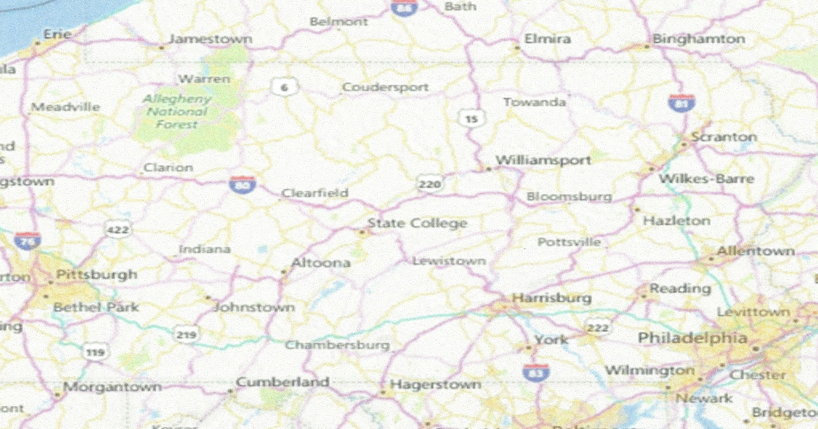
What is “Rural” for USDA-RD Housing? – Housing Eligibility Areas – Everything not yellow

Slide 37
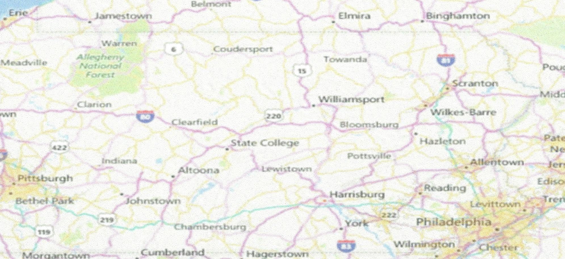
What is Rural for USDA-RD Business Programs? Business Eligibility Areas – Everything not yellow
Value Added Producer Grants (VAPG) and Rural Energy for America Grant and Loan Program (REAP) have NO Rural Area requirement

Slide 38
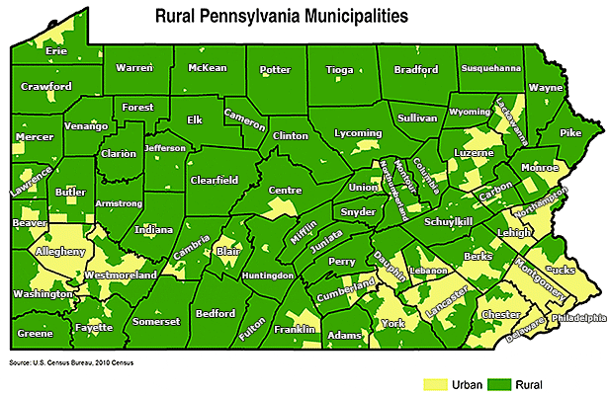
How the “Center for Rural Pennsylvania” defines rural: (state government vs federal government in PA)

Slide 39
How Rural Development can support Pennsylvania’s Veterans
Housing
Home Repair Loans & Grants
Mutual Self-Help Technical Assistance Grants to Non Profits
Housing Preservation Grants – to Nonprofits
Home Loans (Direct and Guaranteed)
Community Facilities
Food – support to Nonprofits for:
Food Pantries
Food Hubs
Health Services
Mental Health – Recovery Centers
Medical Equipment
Telemedicine
Rural Business & Co-operative Service
Job Training Programs thru Nonprofits:
Workforce Development and job placement programs thru RBDG Grant Program
Business Development Programs for Nonprofits supporting Veterans
Relending Programs for Entrepreneurs
Rural Micro-entrepreneur Asst. Program
Grant and Loan GT Programs for Veteran Farmers
Rural Energy for America (REAP Grant & GT loans)
Value Added Producer Grant
Business & Industry Guarantee Loans

Slide 40
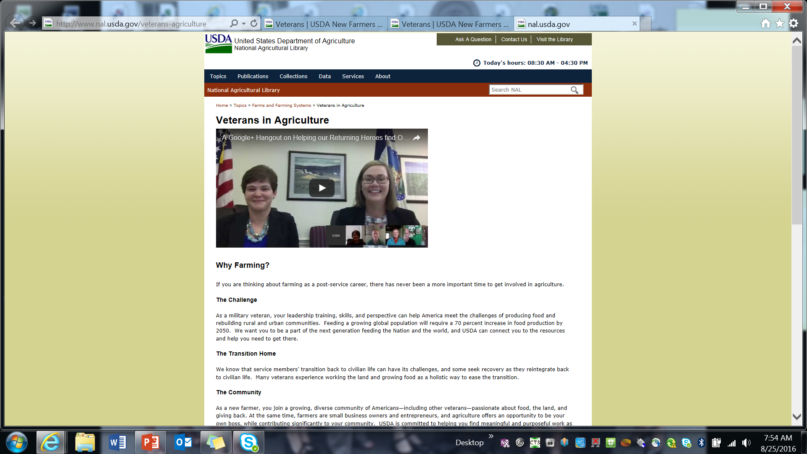
http://www.nal.usda.gov/veterans-agriculture

Slide 41
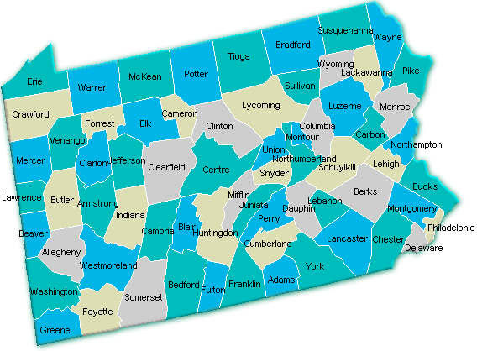
PA Rural Development – where offices are located
http://offices.sc.egov.usda.gov/locator/app?service=page/CountyMap&state=PA&stateName=Pennsylvania&stateCode=42

Slide 42
Office contacts – STATE Community Economic Development Coordinators *Tom Wellington – Lycoming Area Office 570-433-3902 ext. 114 * Trudy Moore – Cumberland Area Office 717-218-3002 ext. 110 * Gary Reed – Westmorland Area Office 742-853-5555 ext. 126
Crawford Area Office
814-336-6155 ext. 4
Clinton Area Office
570-726-3196 ext. 4
Lycoming Area Office
570-433-3902 ext. 4
Wyoming Area Office
570-836-5111 ext. 4
Lehigh Area Office
484-795-7619
Lebanon Area Office
717-272-3908 ext. 6
Cumberland Area Office
717-218-3002
Westmorland Area Office
742-853-5555 ext. 4
Butler Area Office
742-482-4800 ext. 4
Harrisburg State Office
717-237-2299

Slide 43
NEXT MEETING
Friday, October 14, 2016 at 10:00AM
Arrowheads Community Club
Fort Indiantown Gap
Annville, PA 17003
As of 23 Sep 15
> community > commonwealth
> country

